Slide 1



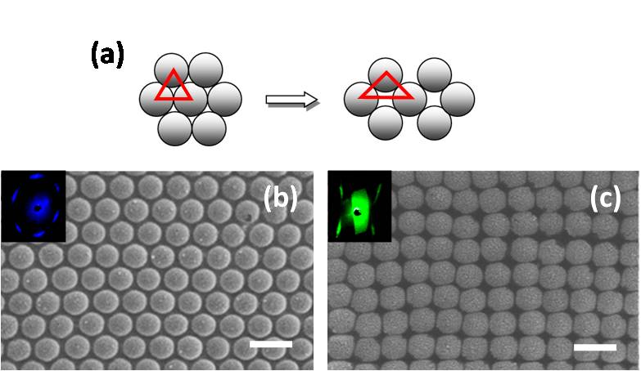
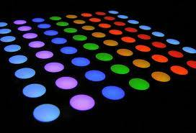
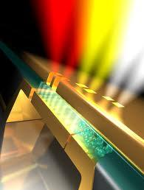
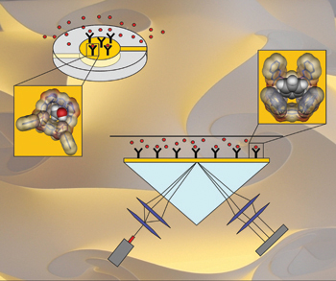
Tunable surface plasmon polaritons of silver capped two-dimensional colloidal crystals on stretchable substrate
Xiaolong Zhu, Lei Shi, Xiaohan Liu and Jian Zi
PBG Group, Department of Physics, Fudan University, Shanghai, China
A simple and comprehensive method for fabricating metallically capped two-dimensional (2D) colloidal crystals on elastic polydimethylsiloxane (PDMS) substrate is demonstrated. This composite supports surface plasmon polaritons, whose energies are sensitive to the geometry of the 2D lattice structures. Because of the high ductibility of elastic PDMS membrane, the lattice structures of metallically capped array can be controlled by expanding the PDMS membrane. This provides a promising approach to tune surface plasmon polaritons, thus realize flexible plasmonic devices with strain sensitivity and reversible-repeatable color changing.
Sample fabrication and SEM images
Measured optical reflectance spectra of the composite sample
The incident angles are shown in downright panel.
(a-f) Optical pictures of 2D silver nanocaps on PDMS after stretching at different strain. Scale bar in (a) is 100μm. (g) Reflectivity of the sample with applied strain. For clarification, the curves are displaced along the vertical axis. The arrow direction indicates the red shift of the dips caused by stretching
(a) Schematics of the lattice change with stretching. (b,c) SEM images of the sample before (b) and after (c) the strain is applied. Scale bar: 1μm. Insets show the light diffraction patterns.
Summary a simple and accomplished method for fabricating metallically capped two-dimensional colloidal crystals on stretchable substrate is demonstrated. By combining self-assembled colloidal crystals with elastic PDMS film, a series of structures with novel optical properties and versatile applications could be developed. The 2D lattice constant of metallic caps can be controlled by expanding the PDMS membrane. It is worth nothing to achieve flexible plasmonic devices with strain sensitivity and reversible-repeatable color changing..
Perspective
Solar cell Photo-catalyst Sensor

