Slide 1
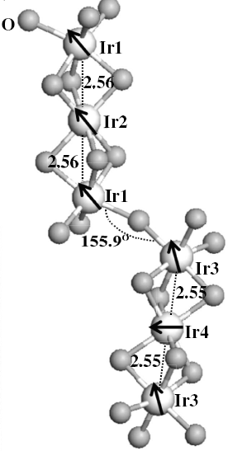
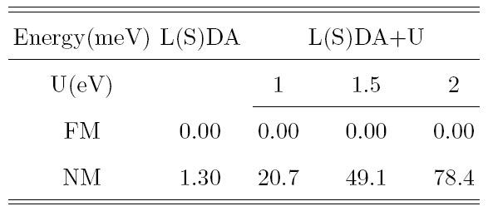
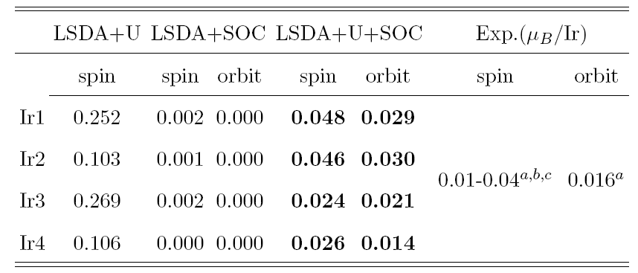
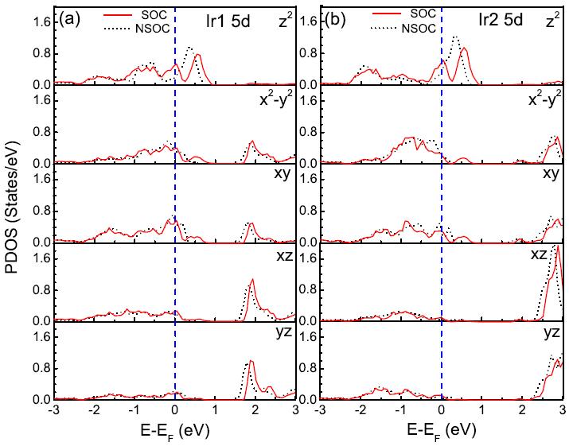
Crucial interactions in BaIrO₃ : Spin-orbit coupling and Coulomb correlation
W.W. Ju (琚伟伟) and Z. Q. Yang*(杨中芹)
Abstract
The electronic structures of perovskite-like BaIrO₃ are investigated using local spin density approximation (LSDA) as well as the LSDA plus Hubbard U (LSDA+U) scheme. The ferromagnetic ground state can be obtained only when the on-site Coulomb interaction is considered. The spin-orbit coupling (SOC) can not be neglected due to the existence of orbital angular momentum on Ir 5d electrons, as have been found recently (PRL105, 216407 (2010)). The calculations including SOC and on-site Coulomb interaction can give the proper spin and orbital magnetic moments, in agreement with the experimental results.
Crystal structure and Method
Space group: C2/m (No.12)
Unit cell parameters: a=10.0052Å b=5.7514Å c=15.1742Å β=103.274º
Feature: Two kinds nonequivalent Ir₃O₁₂ clusters made of face-sharing IrO₆ octahedra,
connected by corner sharing and long axis are tilted by about 12º
Magnetic property: Ferromagnetic ground state
Method: Local spin density approximation (LSDA)
On-site Coulomb interaction U on Ir 5d orbital
Spin-orbit coupling (SOC)
Results
The upper table presents the relative values of total energies for ferromagnetic (FM) state and nonmagnetic (NM) state based on L(S)DA and L(S)DA+U method. The L(S)DA+U calculations give relatively large energy difference stabilizing the FM ground state of BaIrO₃. The energy difference becomes larger with the U value increasing, which distinctly suggests on-site Coulomb interaction is indispensable in correctly describing the electronic structures of BaIrO₃.
The spin and orbital magnetic moments of each Ir atom within different calculation methods are presented in the lower table. The spin magnetic moments of each Ir atom remarkably decrease after SOC effect is considered. When on-site Coulomb interaction (U=1.5 eV) and SOC are synchronously considered, spin and orbital magnetic moments of Ir atoms can almost accord with the experimental results.
Discussion
The comparison of PDOS with and without SOC may shed light on the question why SOC can produce notable influence on the magnetism of Ir atoms. The SOC influences DOS distribution of Ir-5d orbitals, making them become broader in the vicinity of the fermi level. The extended electron distributions not only strengthen direct Ir-Ir interaction but also enhance hybridization between the Ir 5d and O 2p, leading to the decrease of spin magnetic moments of Ir atoms. Strong 5d-2p hybridization and a small exchange splitting on 5d orbitals were believed to be the reasons of small Ir moments in previous study, but our results indicate they are also suppressed by SOC effect and direct Ir-Ir interaction.
Conclusions
I. The electronic structures of BaIrO₃ have been studied by first-principles calculations within LSDA+U+SOC method.
II. The On-site Coulomb interaction is important to obtain the magnetic ground state of BaIrO₃.
III. The SOC effect play an important role in the investigation on the magnetic properties of this compound.
References
(1) M. A. Laguna-Marco, D. Haskel , et. al. ,Phys. Rev. Lett. 105, 216407 (2010).
(2) G. Cao, J. E. Crow, el. al. ,Solid State Commun. 113, 657 (2000).

