Slide 1

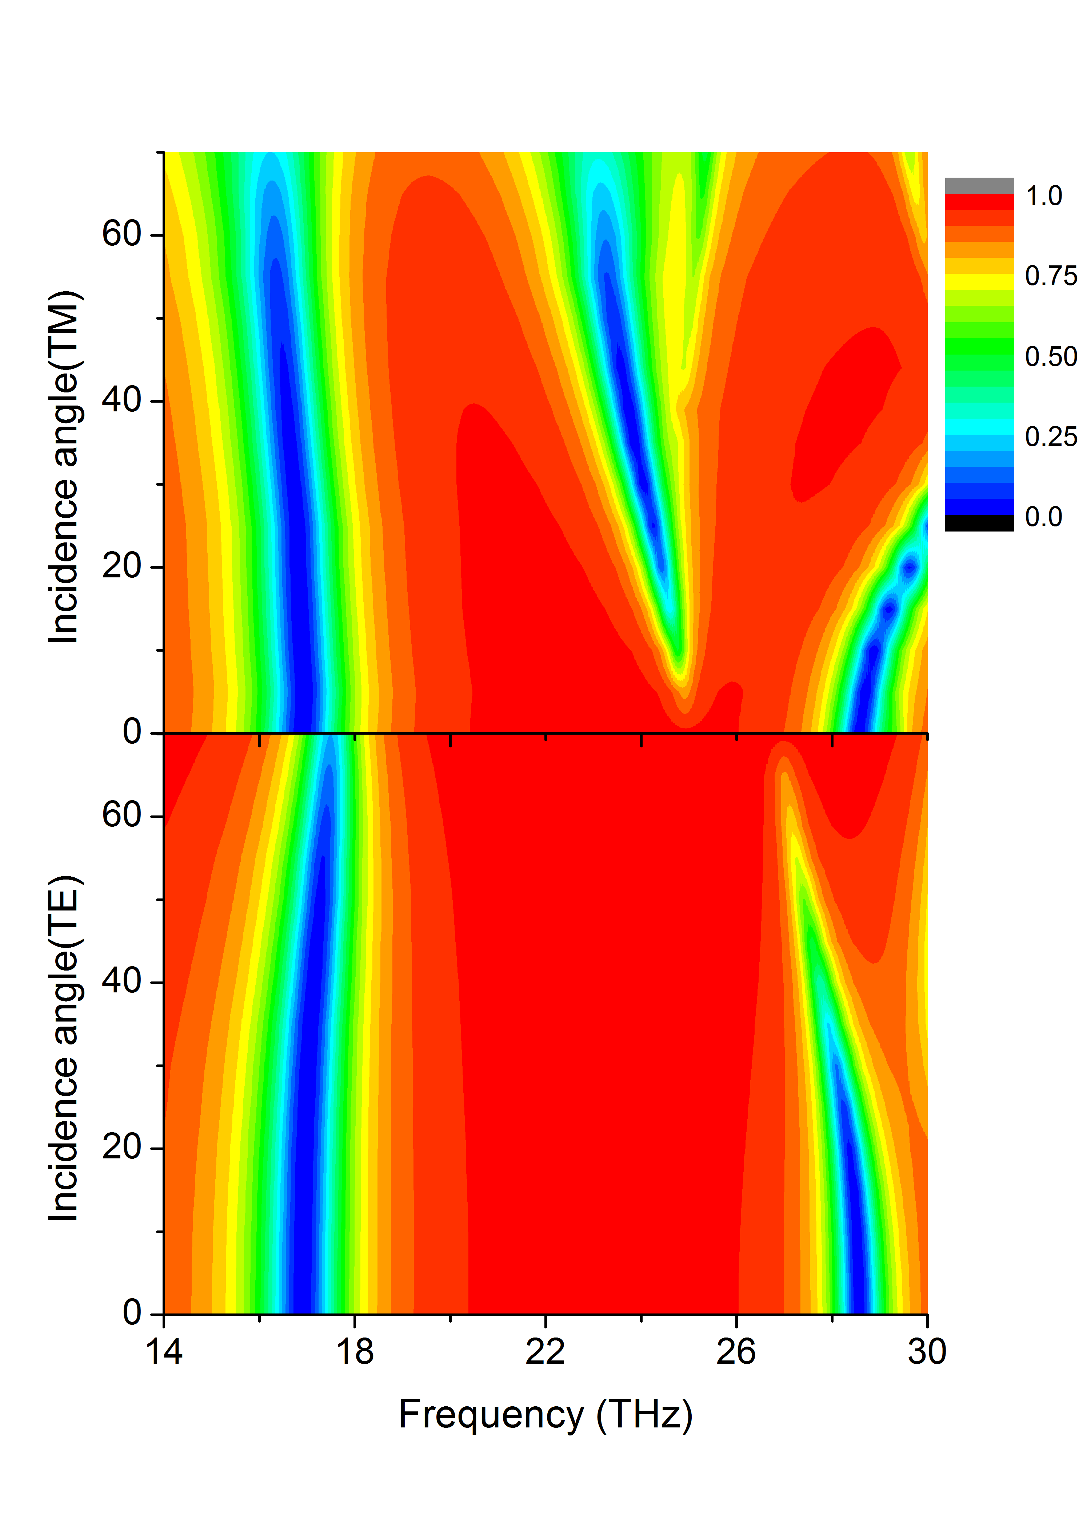
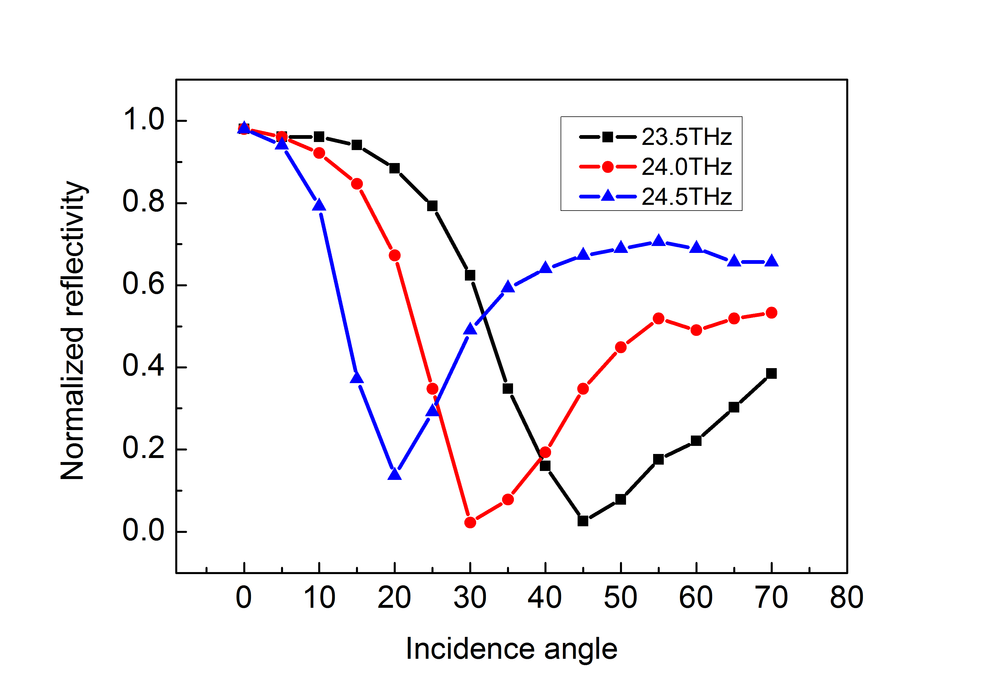
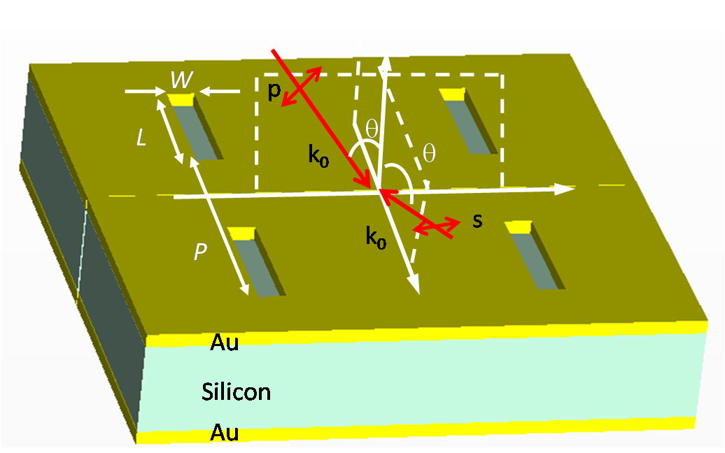
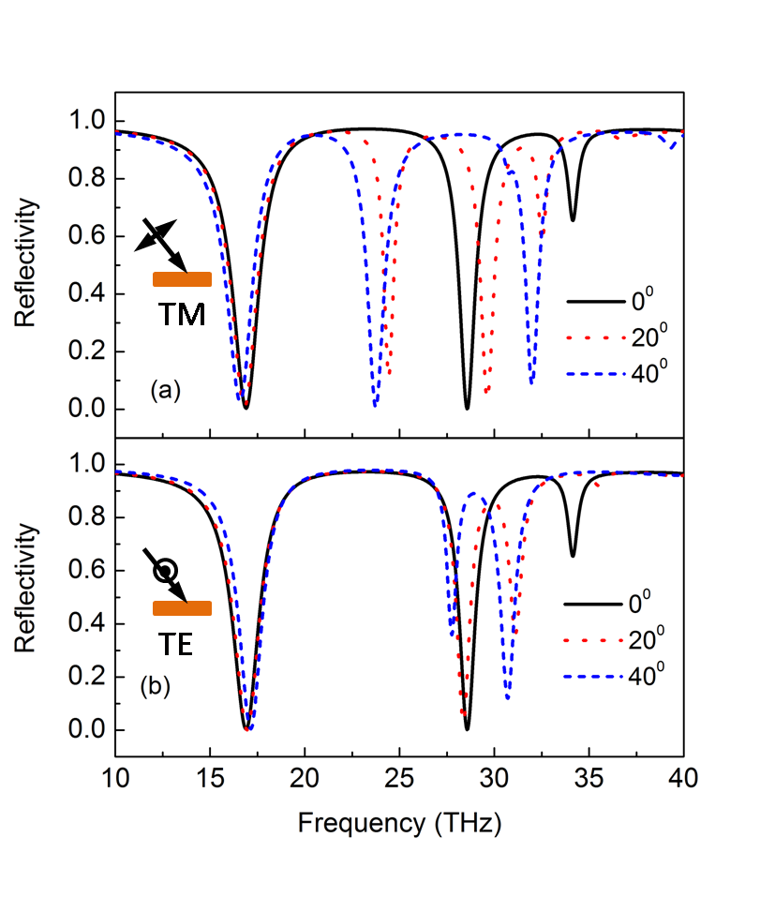
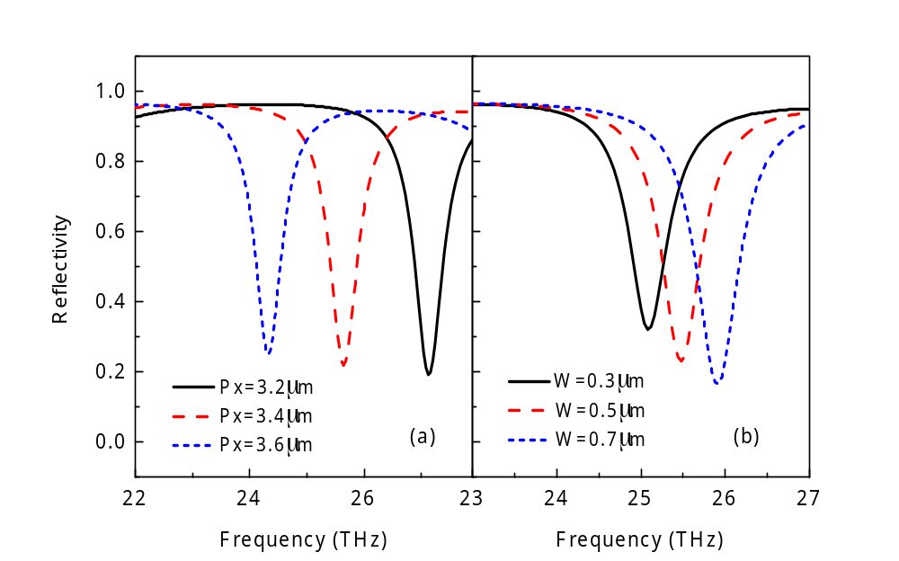
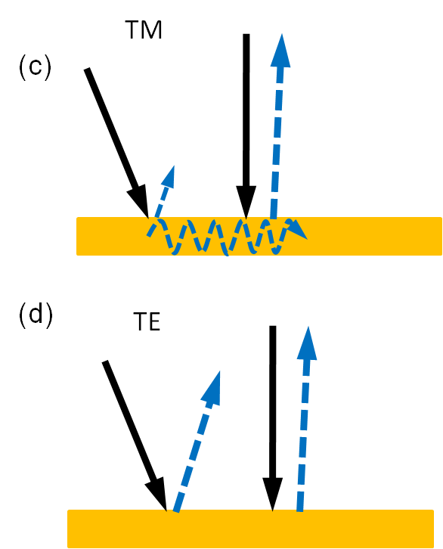
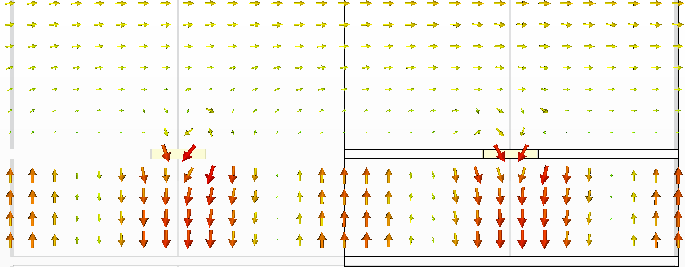
A polarization-selective collimation effect through reflection on plasmonic cavity
Feilong Mao, Jinjin Xie, Lijian Zhang，Zhenghua An
Laboratory of Advanced Material ., Fudan Univ., Shanghai, People’s Republic of China
Abstract
Polarization-selective collimation effect
A thin gold film perforated with subwavelength holes is known to exhibit extraordinary transmission, irrespective of the state of polarization and the angle of incidence. Here, we report that, a metal-dielectric-metal cavity with patterned top metallic slab is able to achieve maximum absorption over 70% for a wide incidence angle range 15-65° for the TM wave , but reflects almost 100% of TM wave under normal incidence and TE wave in both normal and oblique cases. Numerical studies show that a even Fabry-Perot mode within the core along the surface is attributed to this interesting phenomenon.
and (b) Contour plot of reflection spectra of TM and TE polarization wave with different incident angle. For TM wave at frequency 23-25THz, the cavity can achieve a maximum absorption over 70% for wide angle range from 15°-65°.
(c) Reflectivity dependence of incidence angle, it gives a guide line for collimate light through reflection, e.g. if the light is slight oblique, it should choose a 24.5THz like angle dependence absorption function.
(a)
Results
Plasmonic cavity and wave incidence
(b)
(c)
Metal-dielectric-metal plasmonic cavity,
TM and TE polarization wave incident
to the plasmonic cavity with electric
vector perpendicular to the hole length direction
N=2 Fabry-Perot mode excited by TM wave
Polarization-selective collimation effect
Reflection spectra calculated using various
typical hole array parameters for TM wave at
a fixed incident angle 15°.
The schematic of horizontal Fabry-Perot
mode and electric field distribution of a
collimation resonance
Summary
We report that a plasmonic cavity shows polarization-selective collimation effect through reflection on the patterned metallic slab, it reflects TM wave 100% under normal incidence (0°) while absorb over 70% in a wide angle range from 15°-65°. However, it reflects 100% TE wave whether under normal incidence or oblique incidence. By numerical calculations, we reveal that the N=2 Fabry-Perot mode within the cavity core along the surface can be attributed for this interesting effect.
(a) and (b) The reflection spectra of TM and TE polarization wave with different incident angle. (a) and (b) show that at about frequency 25THz, the cavity absorbs nearly 100% oblique incident TM wave while reflects 100% normal incident TM waves, however, the cavity reflects 100% TE wave no matter under normal or oblique incidence.
(c) and (d) is a schematic of the plasmonic cavity reflection properties corresponding to (a) and (b). From (a) and (c), we see that the cavity absorb oblique incident TM wave while reflects normal incident TM wave, thus, when normal and oblique TM wave incident to the cavity, the proportion of normal light will be increased after reflection, as a result, it can collimate TM wave through reflection.
References
[1] A. P. Hibbins and J. R. Sambles. Squeezing millimeter waves into microns, Phys. Rev. Lett 92, 143904 (2004)
[2] Y. Todorov et al, Optical properties of metal-dielectric-metal microcavites in the THz frequency range. Opt. Express 18,13886 (2010)
[3] B. F. Bai, J. Laukkanen, A. Lehmuskero, X. W. Li, and J. Turunen, Polarization-selective window-mirror effect in inductive gold grids. Phys. Rev. B 81, 235423 (2010)

