Slide 1

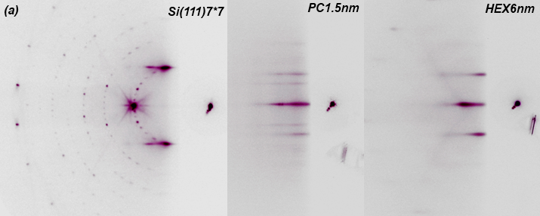
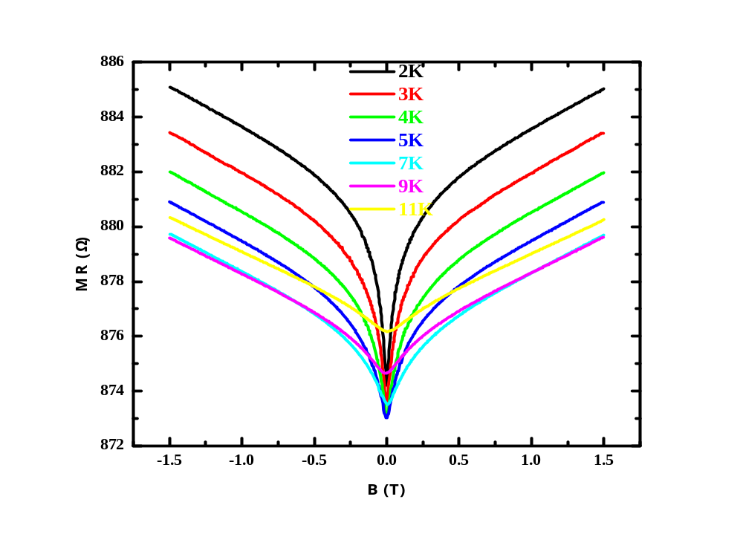
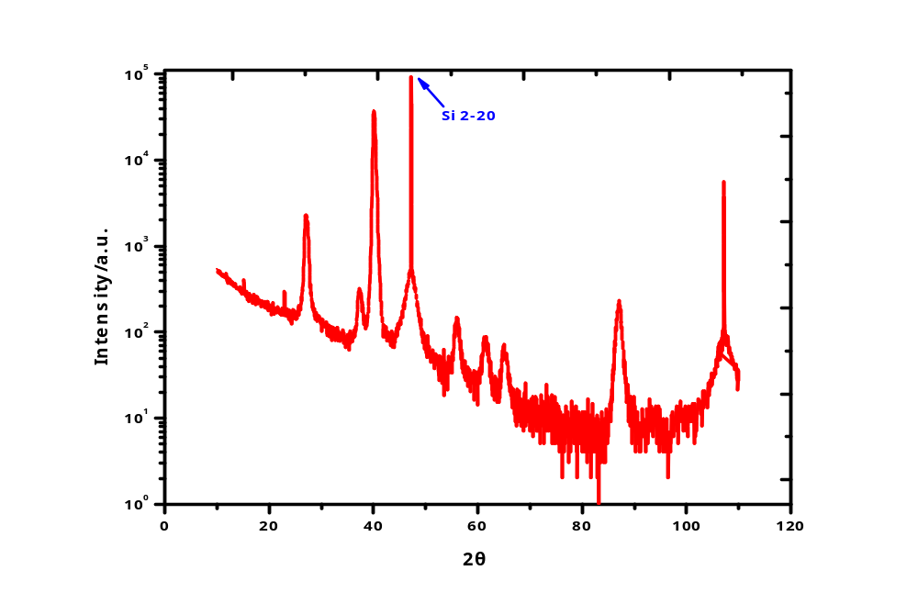
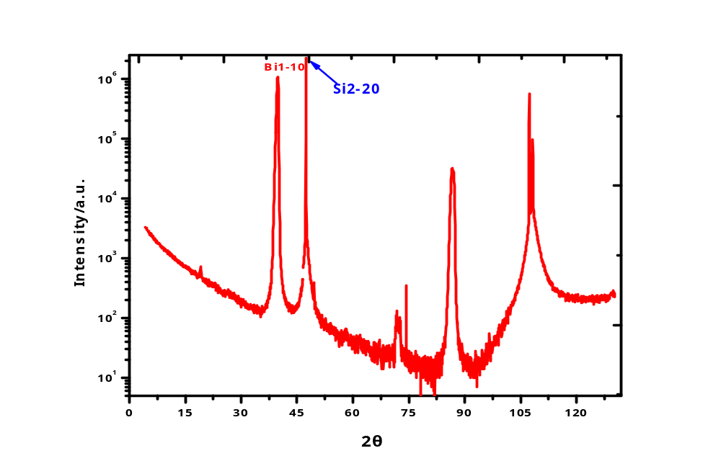
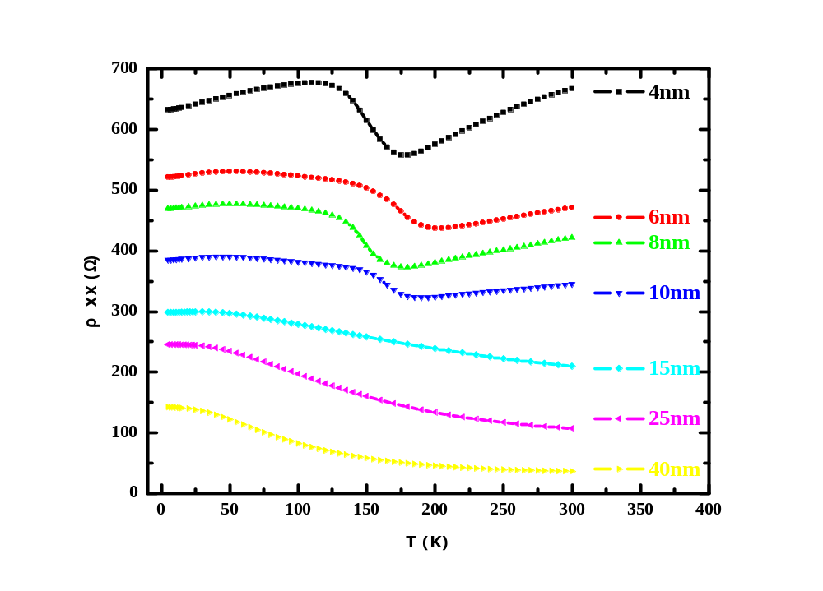
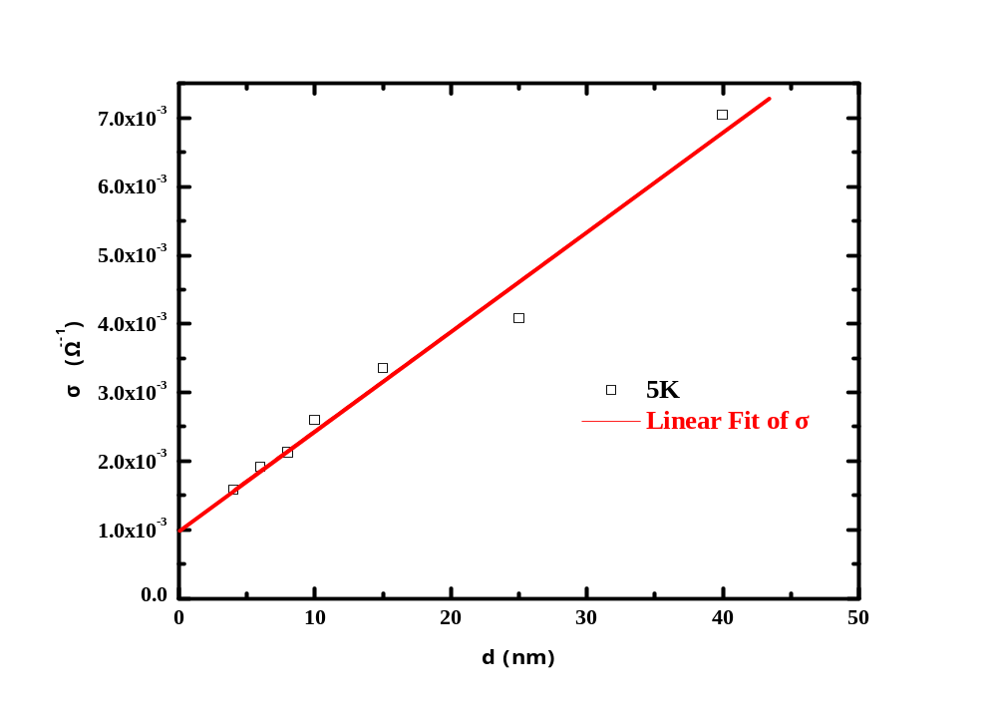
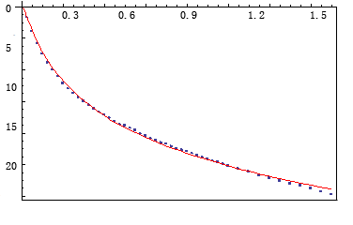

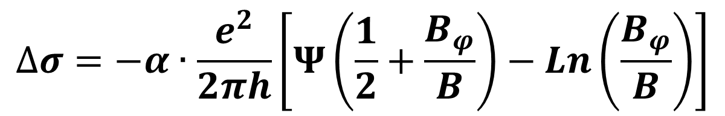
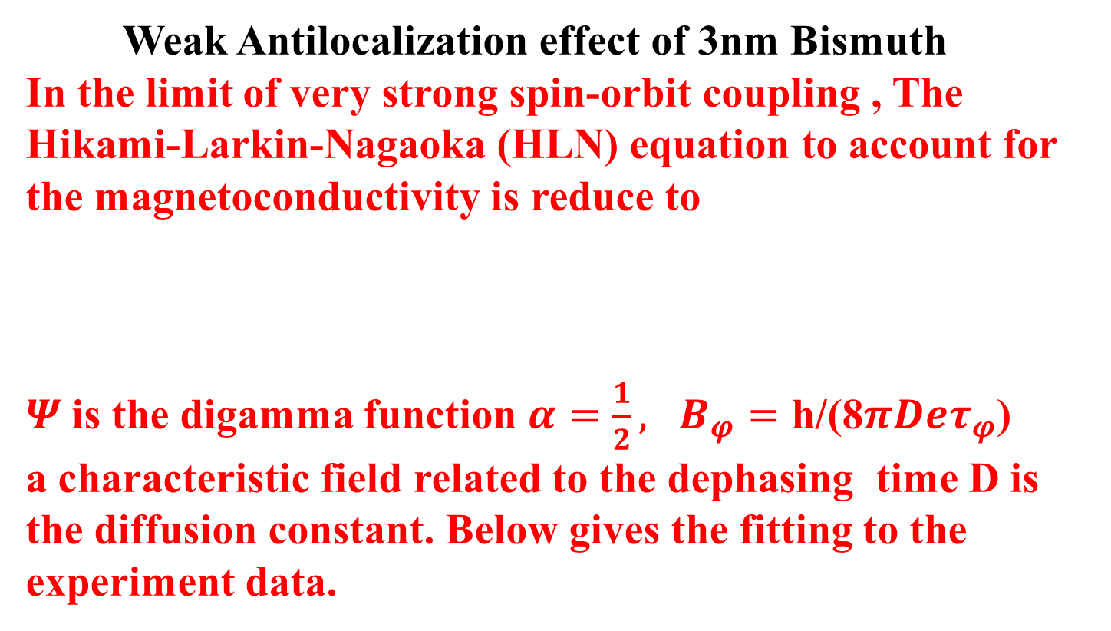

Unconventional longitudinal resistance and magnetoresistance in Single Crystalline Bismuth Thin Film
Kai Zhu, Shunhao Xiao, Xiaofeng Jin
Department of Physics, Fudan University, Shanghai 200433
Bismuth, a prototype semimetal, has unique electronic properties. A semimetal-semiconductor(SMSC) transition is predicted to exist, even after decades of theoretical and experimental works on this still remains a controversial issue. In the present work, the non-monotonic resistivity(conductance) – temperature curve of single crystalline Bismuth epitaxial grown on Si(111)-7*7 shows the nature of competition between metallic surface state and bulk semiconductor. Magneto resistivity of Bismuth ultrathin film at low temperature give support for the two dimensional nature of the surface states.
Semiconductor-to-Semimetal transition
It was predicted that with the decreasing thickness of Bismuth film, a band gap would develop due to the quantum size effect, which lead to semimetal-semiconductor (SMSC) transition[1].
[1] V. N. Lutskii, JETP Lett. 2, 245 (1965), V.B. Sandomirsjii, JETP 25, 101 (1967)
Epitaxial Bismuth thin film on Si (111) substrate
surface
The RHEED pattern and Grazing angel XRD result of Bismuth of different thickness confirms the phase transition from pseudocubic phase (PC) to hexagonal phase (HEX) [2].
d
bulk
[2] T. Nagao, J.T. Sadowski, T. Sakurai PhysRevLett_93_105501(2004)
RHEED of Si(111)-7×7 and Bismuth film of different thickness
Weak Antilocalization in ultrathin bismuth films
Grazing angle XRD of Bismuth with thickness 1.5nm(left) 6nm(right)
Weak Antilocalization effect of 3nm Bismuth
In the limit of very strong spin-orbit coupling , The Hikami-Larkin-Nagaoka (HLN) equation to account for the magnetoconductivity is reduce to
$Ψ$is the digamma function ${α=\frac{1}{2}, B}_{φ}=\text{h}\text{/(8}πDeτ_{φ}\text{)}$
a characteristic field related to the dephasing time D is the diffusion constant. Below gives the fitting to the experiment data.
Transport properties of bismuth thin film
$$∆σ=−α∙\frac{e^{2}}{2πh}\left[Ψ\left(\frac{1}{2}+\frac{B_{φ}}{B}\right)−Ln\left(\frac{B_{φ}}{B}\right)\right]$$
$${10}^{−3}{Ω }^{−1}$$
B (T)
$$∆σ(μS)$$
The competition between metallic surface state and bulk semiconductor give rise a non-monotonic resistance – temperature curve. From the dependence of the sheet conductance on the film thickness
the conductance of the surface states is about ${10}^{−3}{Ω }^{−1}$.
Summary
The predicted semimetal-semiconductor(SMSC) transition in Bismuth thin film does exist. The unconventional transport behavior of Bismuth thin film is due to the competition of semiconductor bulk and metallic surface state.
Weak antilocalization in ultrathin bismuth films give support for the two dimensional nature of the surface states.

