Slide 1

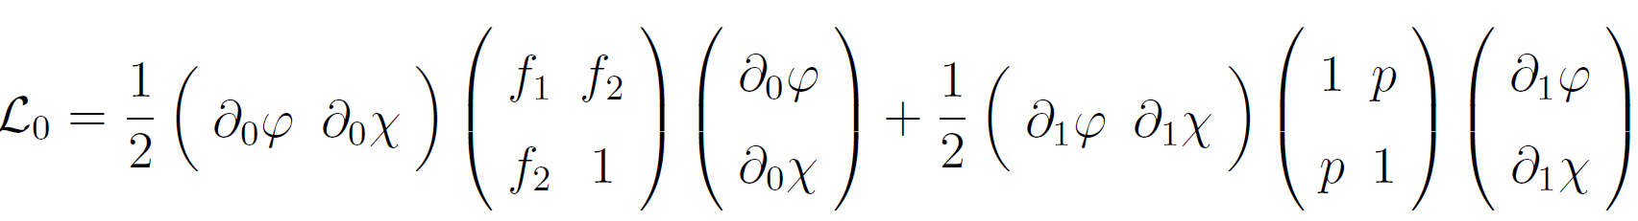
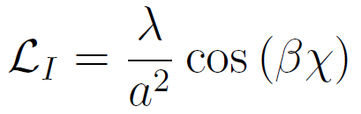






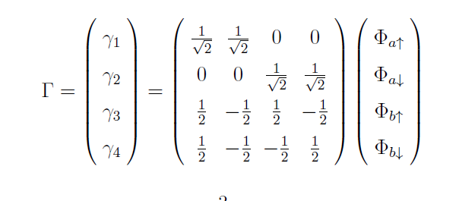




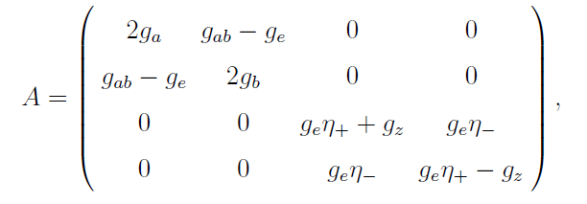
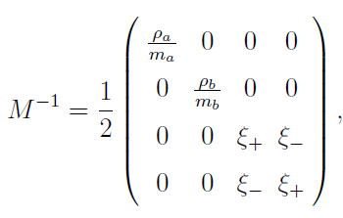



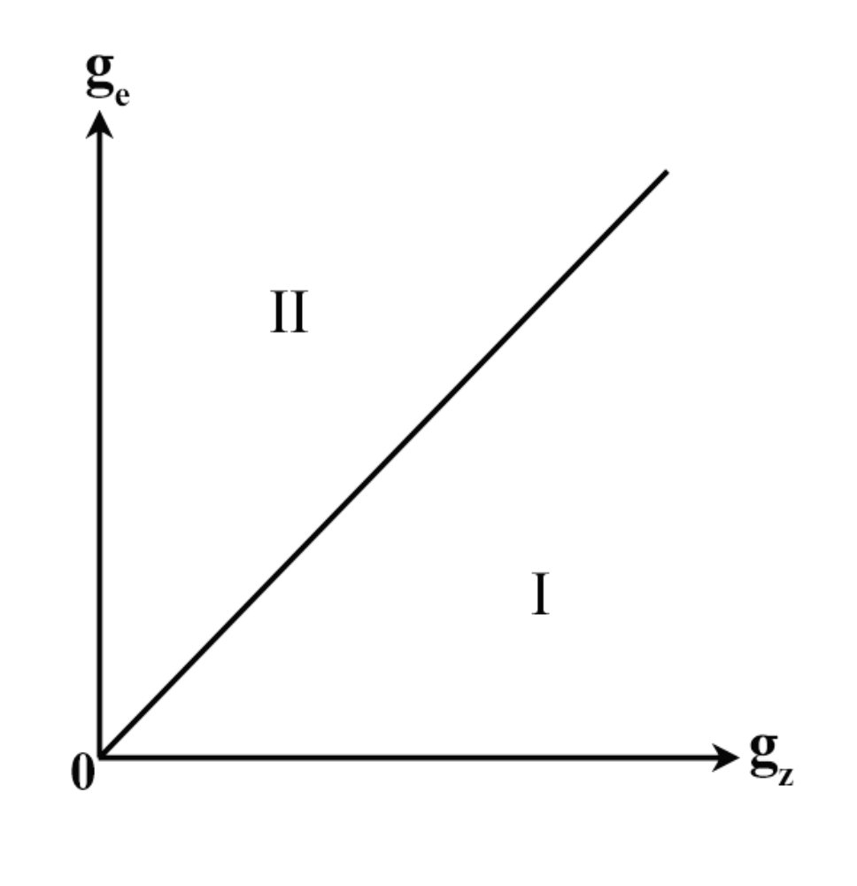
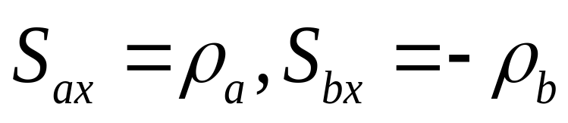
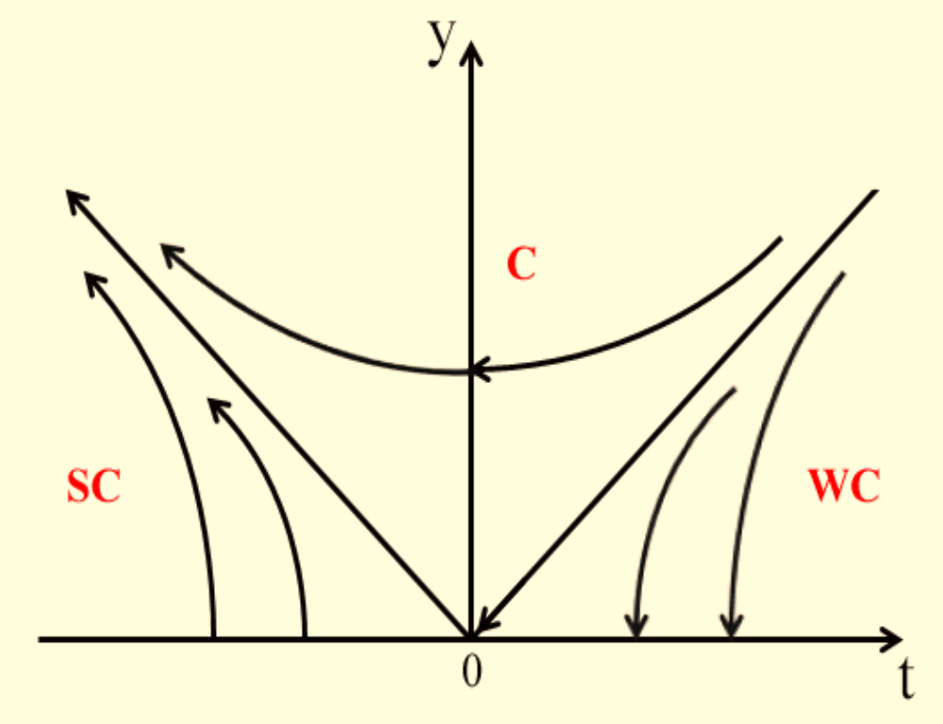

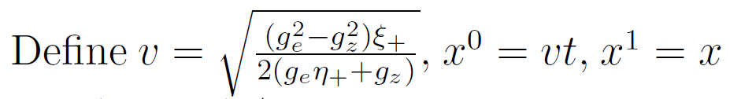



Elementary Excitations and Phase Diagram of Mixed Spin-1/2 Bosons
Ge Li and Shi Yu
Physics Department, Fudan University
We investigate the property of a mixture of two species of pseudospin-1/2 atoms. The ground states of the system with different spin exchange interactions are obtained. In 1 + 1𝐷, the effective theory describes a Sine-Gordon field coupled to a free scalar field.
The relevant Lagrangian is
The effective Hamiltonian is:
where
Which just describes two coupled scalar fields
The low energy effective Lagrangian is :
The RG flow is:
In which
Phase diagran in 3+1D:
Also,
In 1+1D

