Slide 1

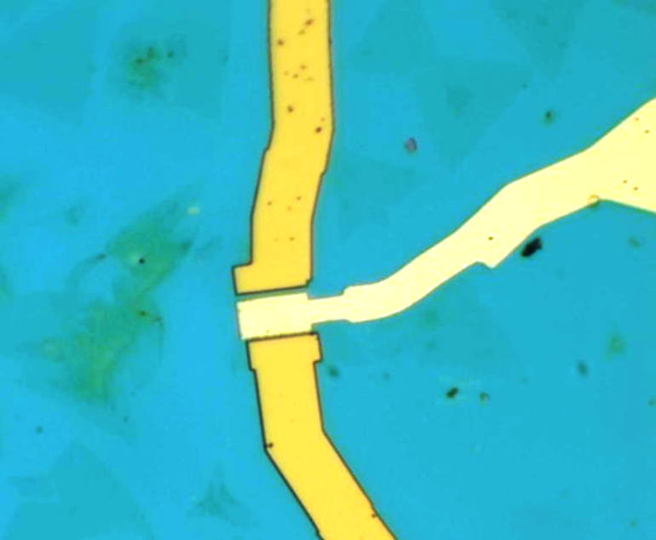
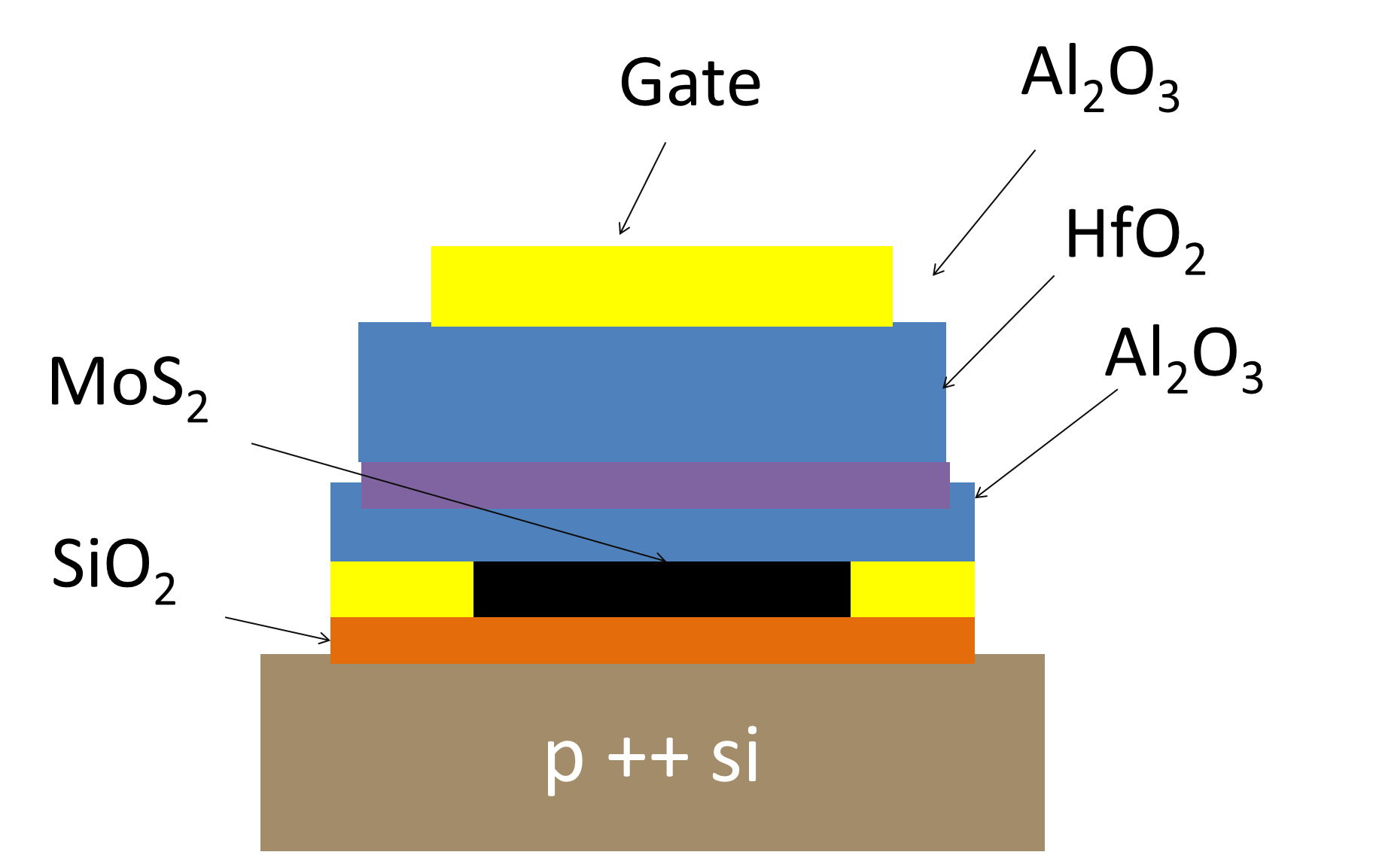
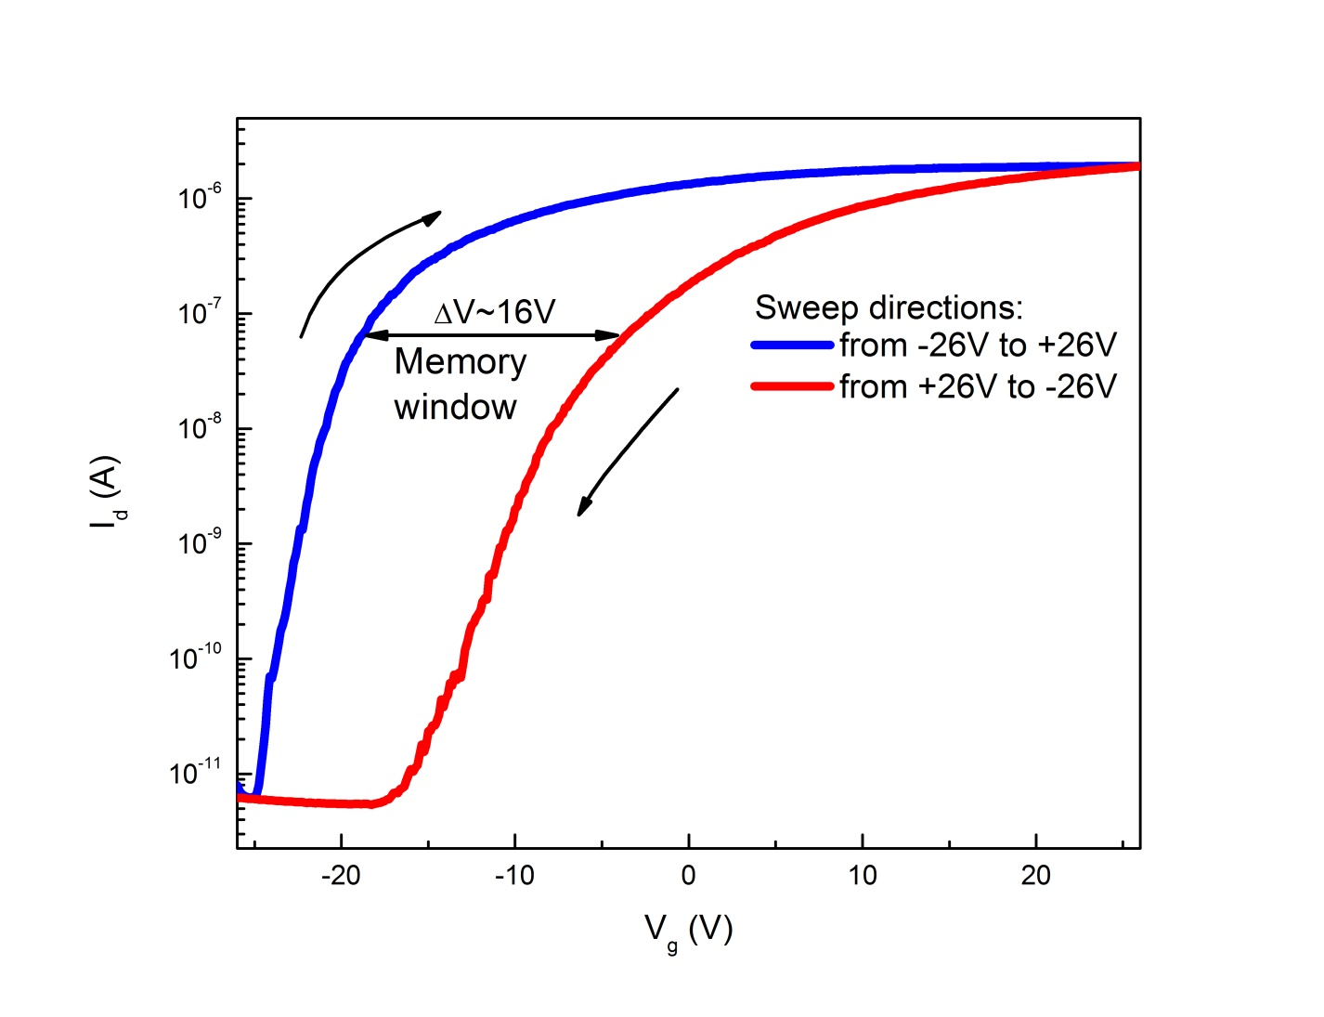
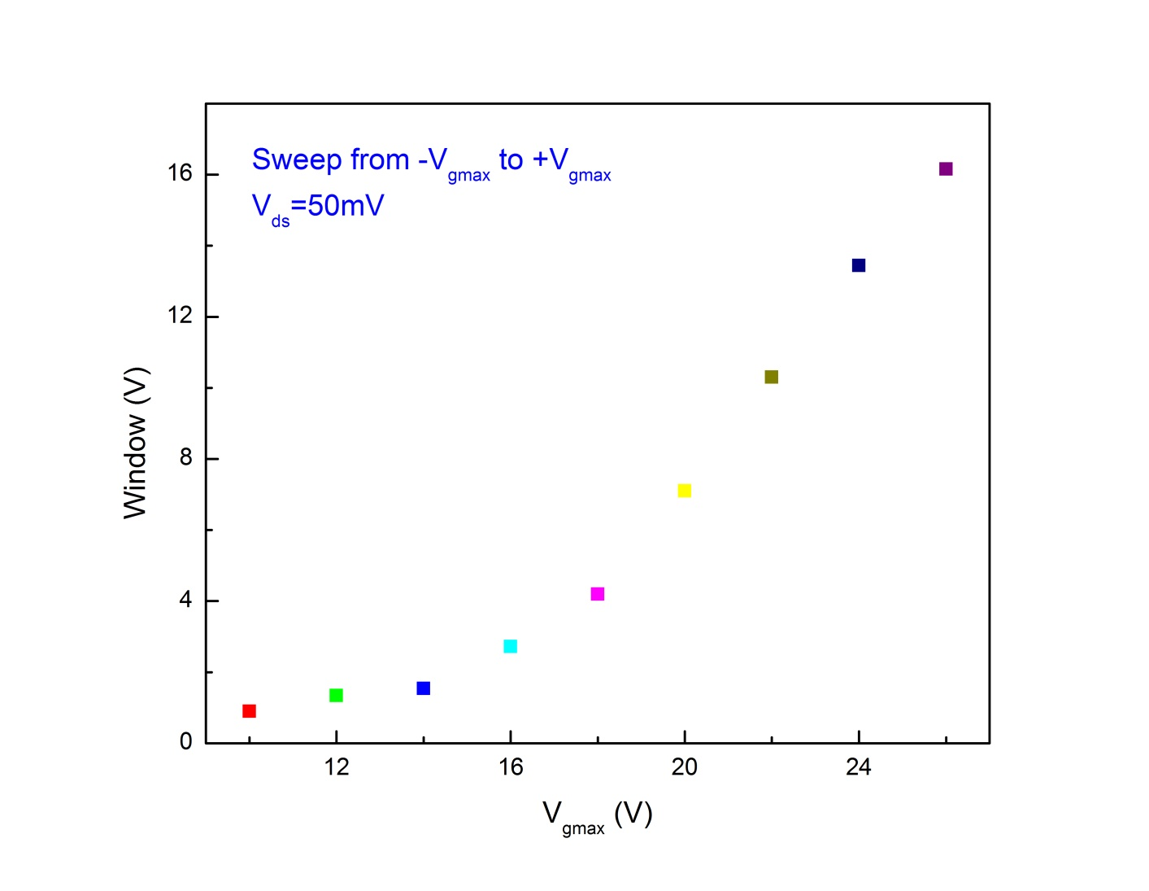
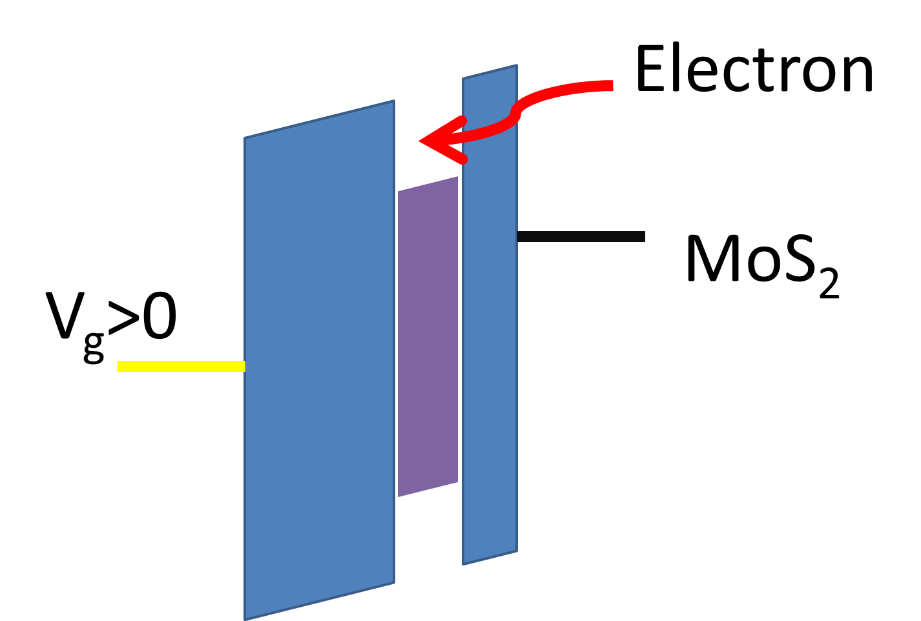
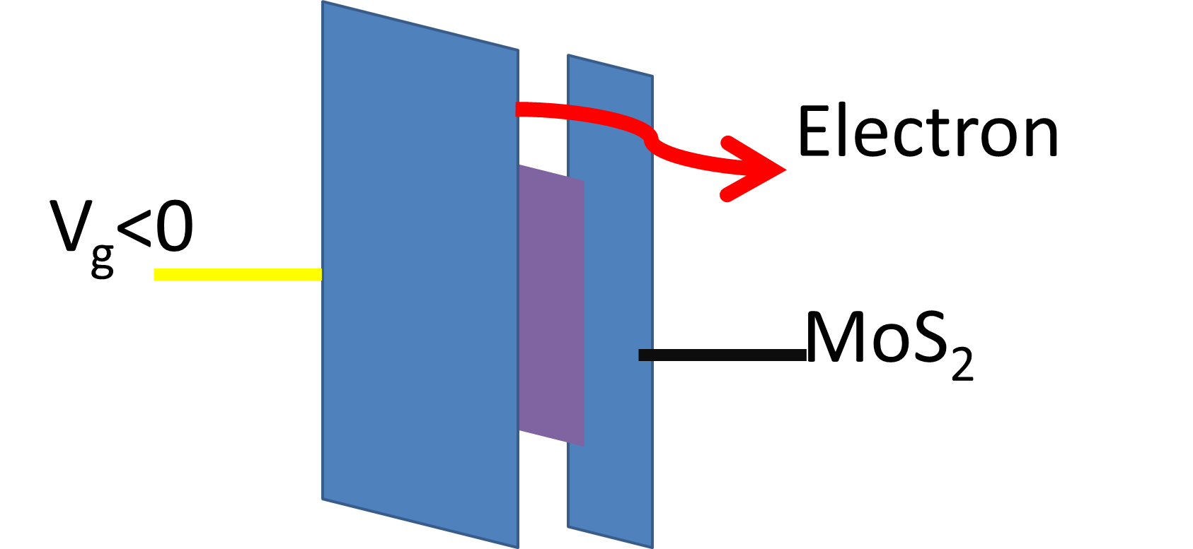
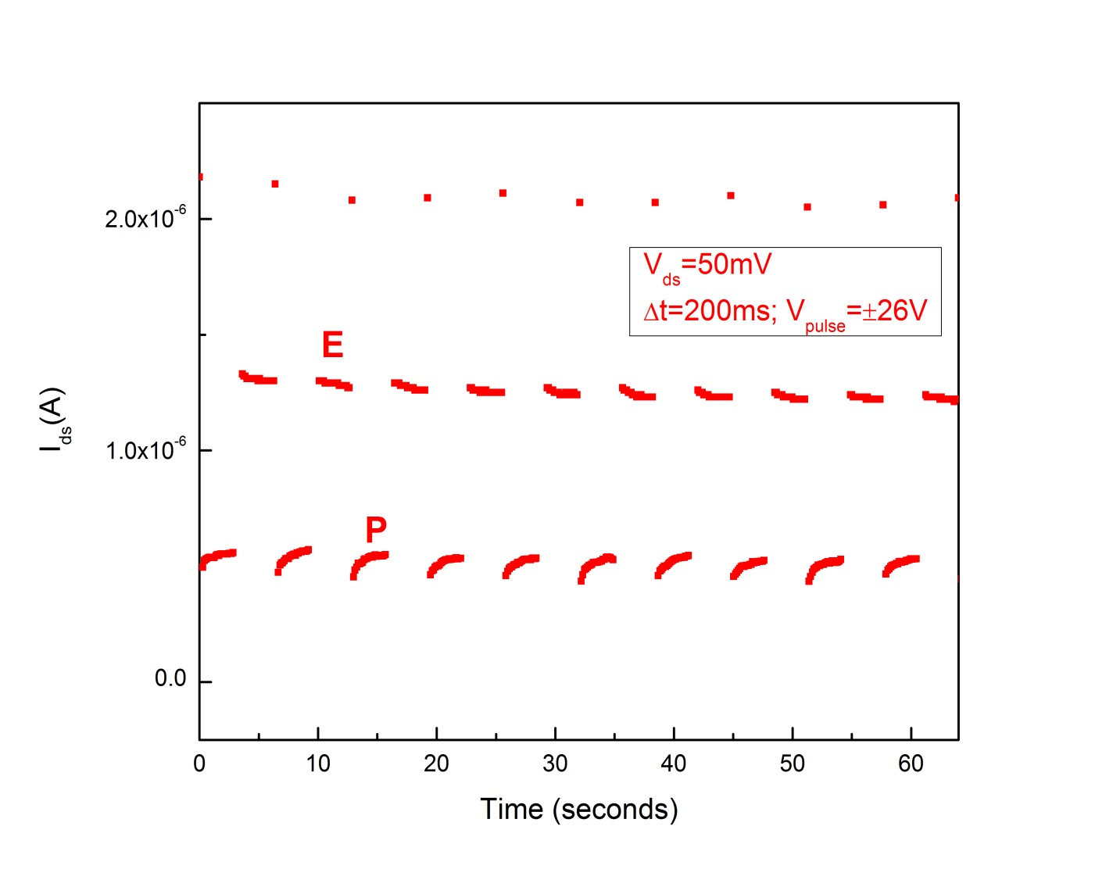
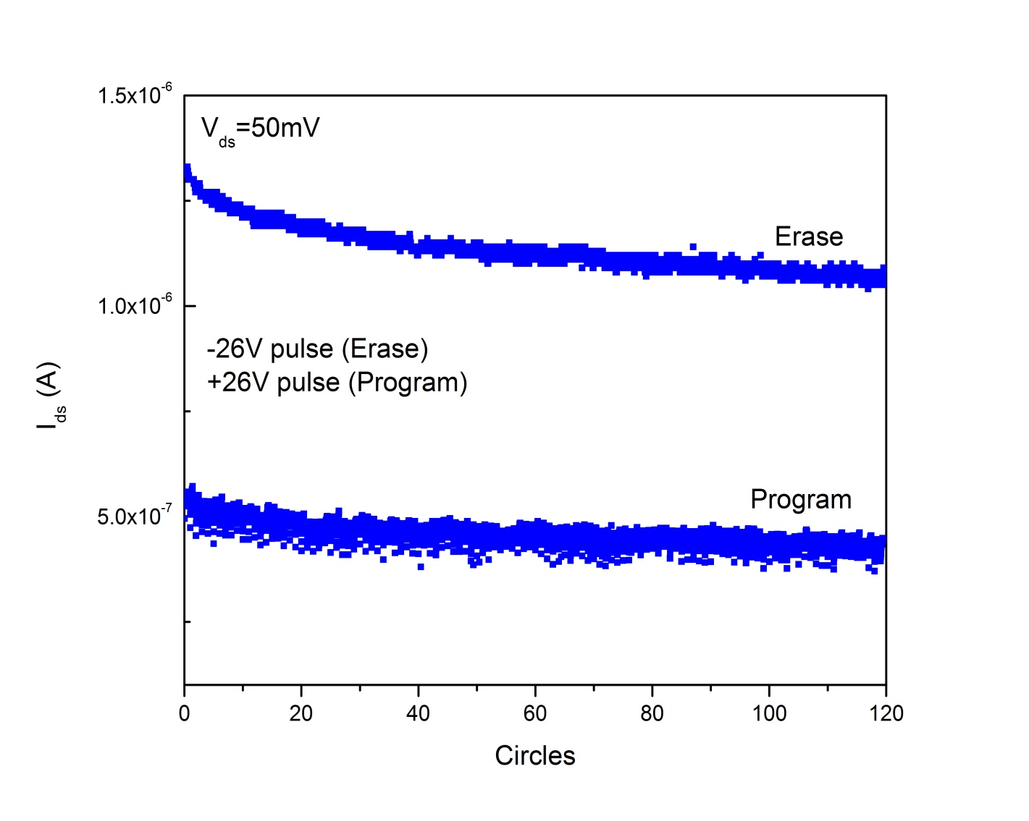
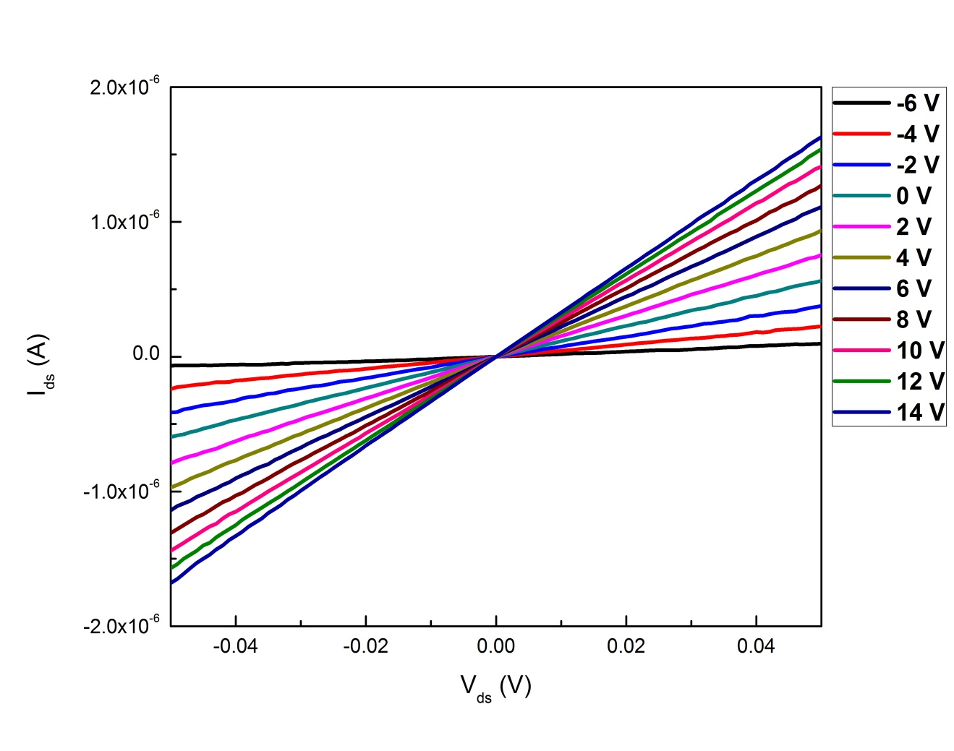
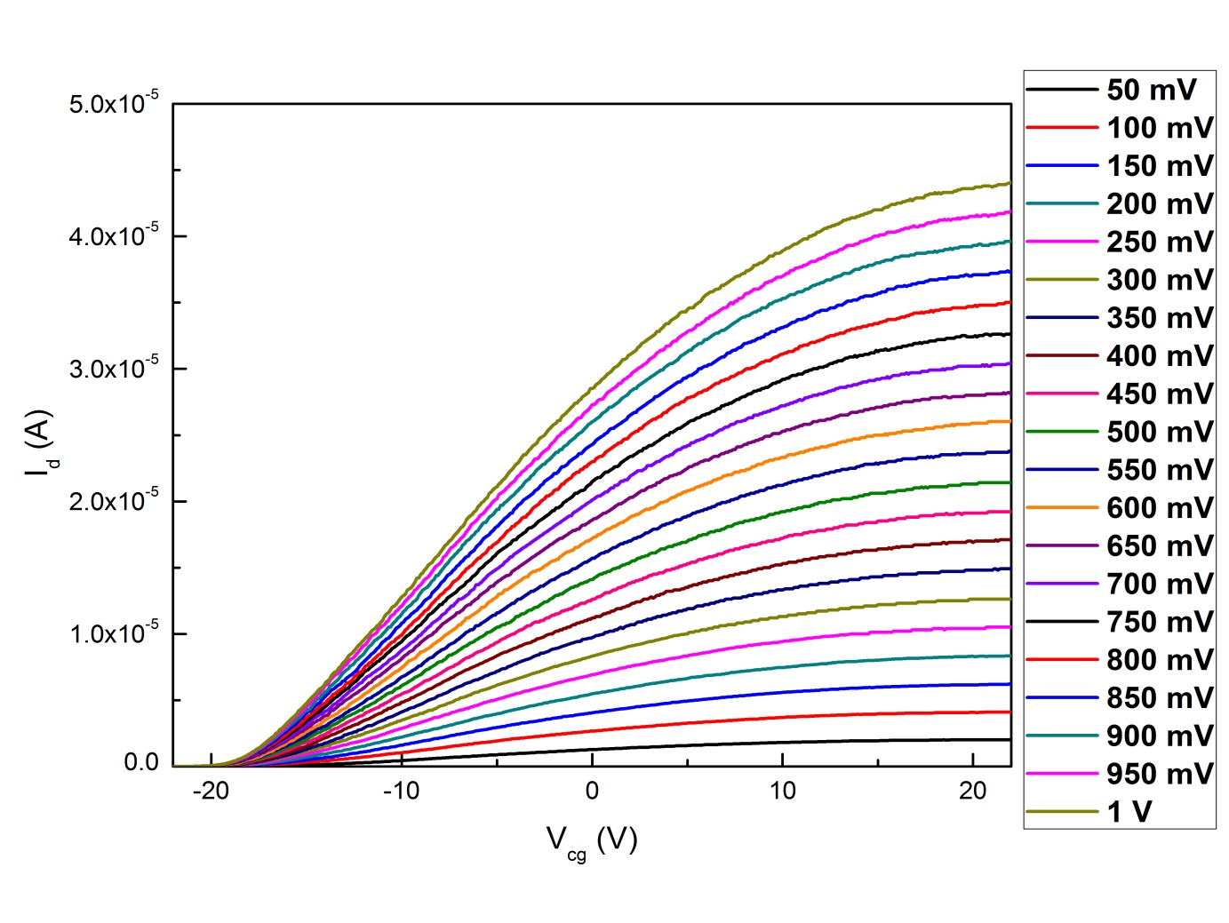
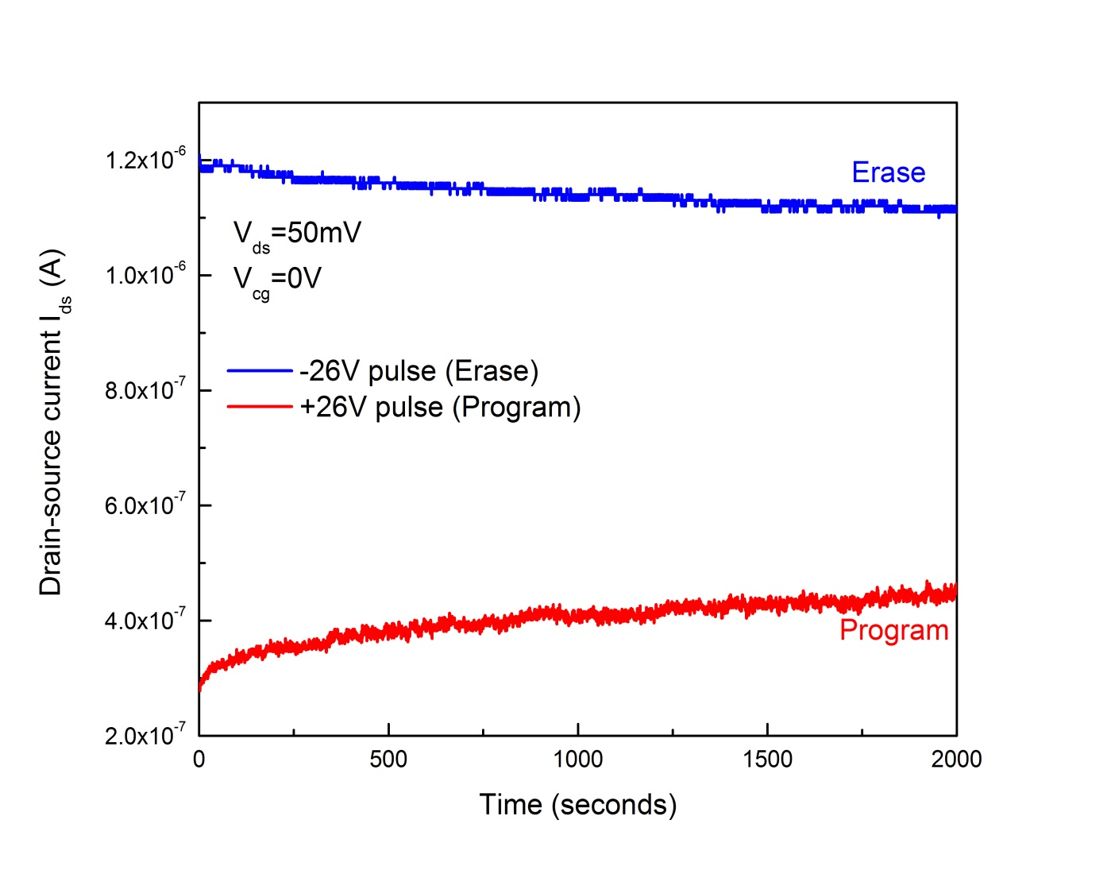
A Novel Charge-trap Memory based on MoS₂
Enze Zhang and Faxian Xiu*
State Key Laboratory of Surface Physics and Department of Physics, Fudan University,
_{Shanghai 200433, China.}
Ⅰ. Introduction: Two dimensional material like graphene and molybdenum disulfide has been extensively studied recently because of their noval physical properties and promising applications in electronic devices. Here, we report on a top gated charge-trap memory composed of a molybdenum disulfide channel and a 3-dimensionl charge-trap gate stack.The fabricated memory device shows a wide memory window of more than 16V at the program/erase voltages of ±26V. Also, it displays a long retention time and highly endurance of over hundreds of cycles.
Ⅱ. Structure:
Ⅳ. Memory performance:
(a)
(b)
(a)
(b)
(c)
(d)
(c)
(d)
Figure 1. (a) Optical image, (b)schematic structure and(c)(d) band diagram of the charge trap memory.
Ⅲ. FET performance:
(a)
(b)
Figure 3.
(a) memory window, (b) memory window’s relation with V_{g.max}, (c)dynamic behavior, (d)endurance and (e)retention time of the charge trap memory.
(e)
Figure2.(a)I_{d}-V_{d} and (b)I_{d}-V_{g} of the charge trap memory.
Ⅴ. Summary :
Our charge trap memory shows a very large memory window of 16V highly endurance of more than 120 circles and a long retention time. The integration of 2-D materials with conventional charge trap gate stacks shows a great prospective in nonvolatile memory devices.
*To whom correspondence should be addressed: faxian@fudan.edu.cn

