Slide 1

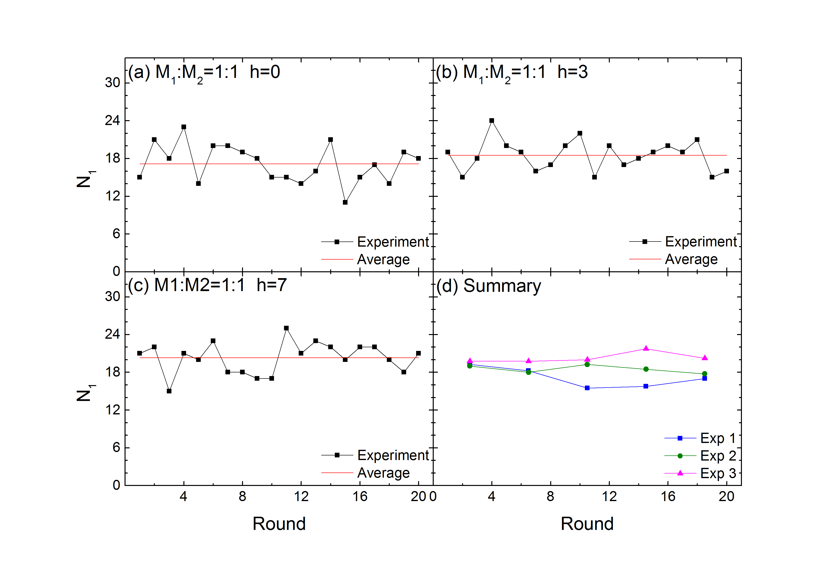
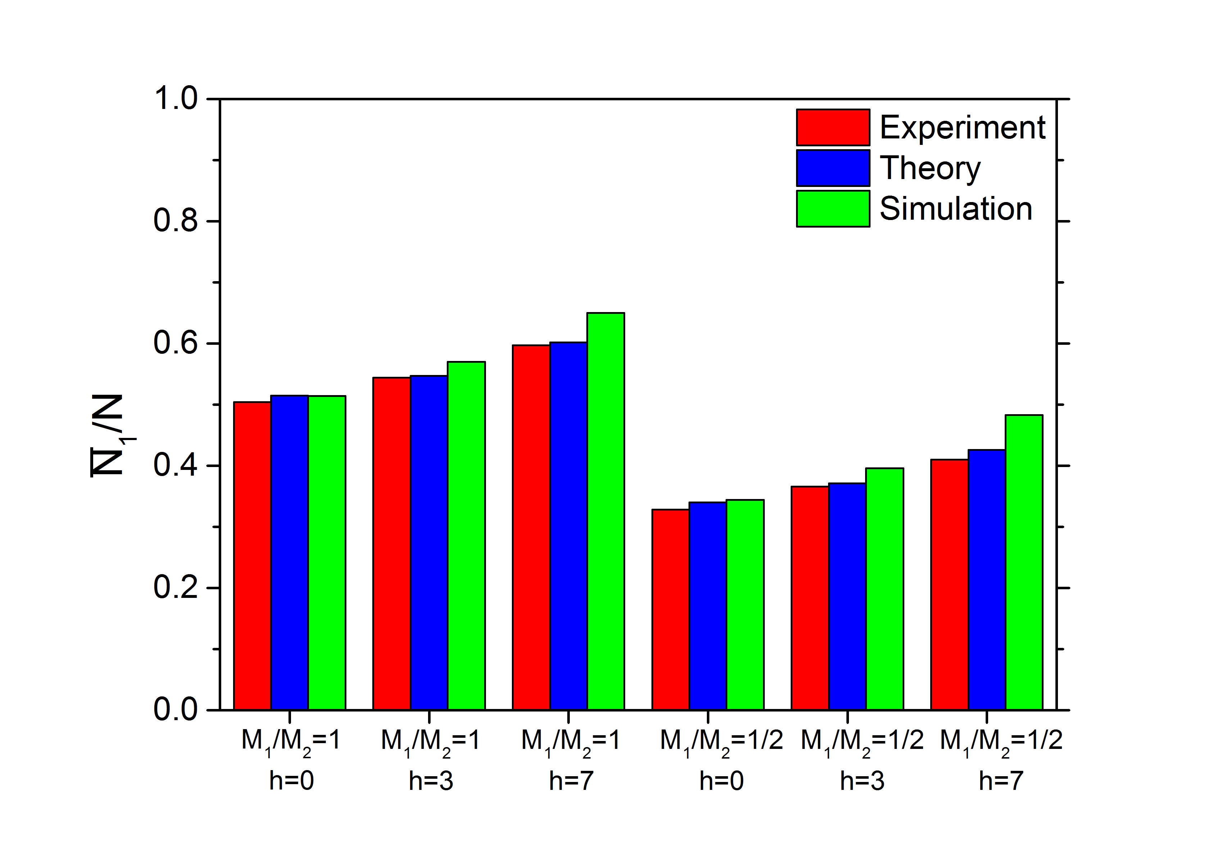
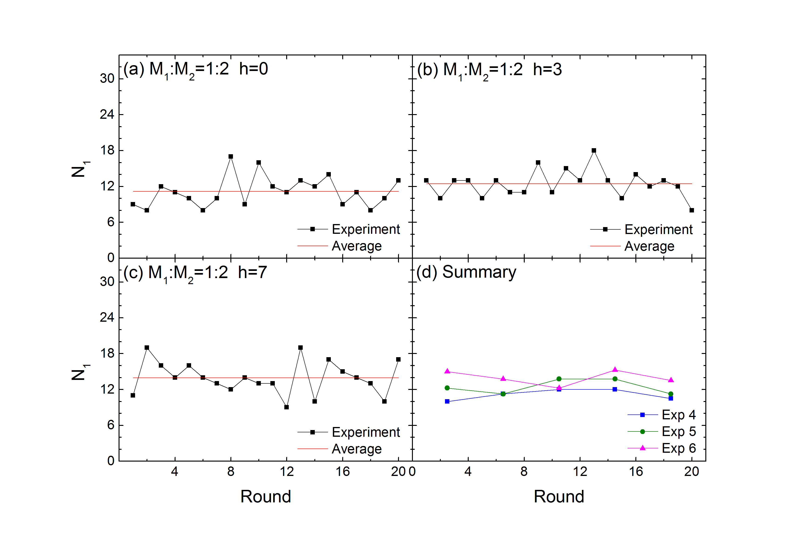
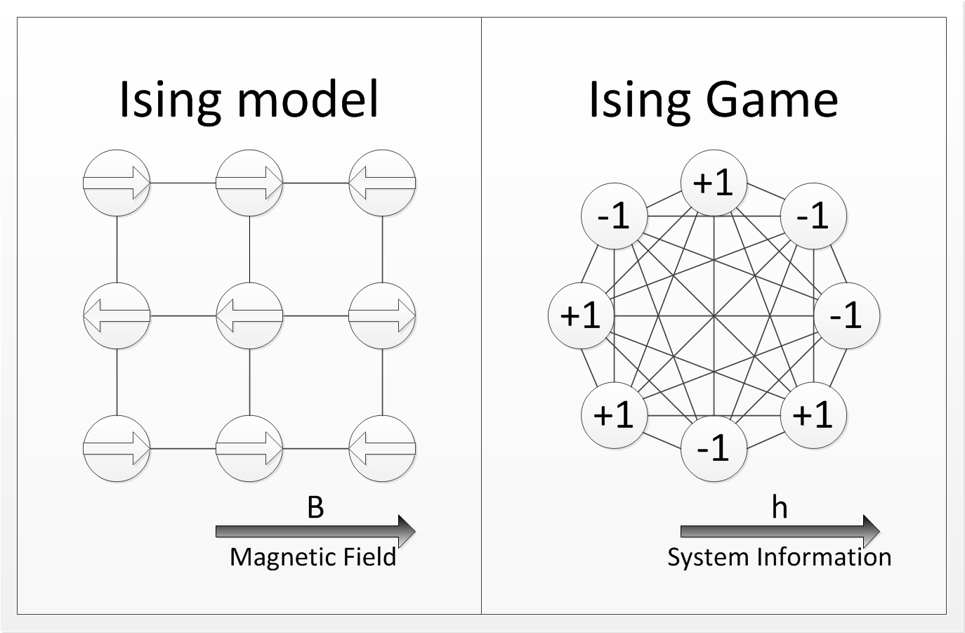
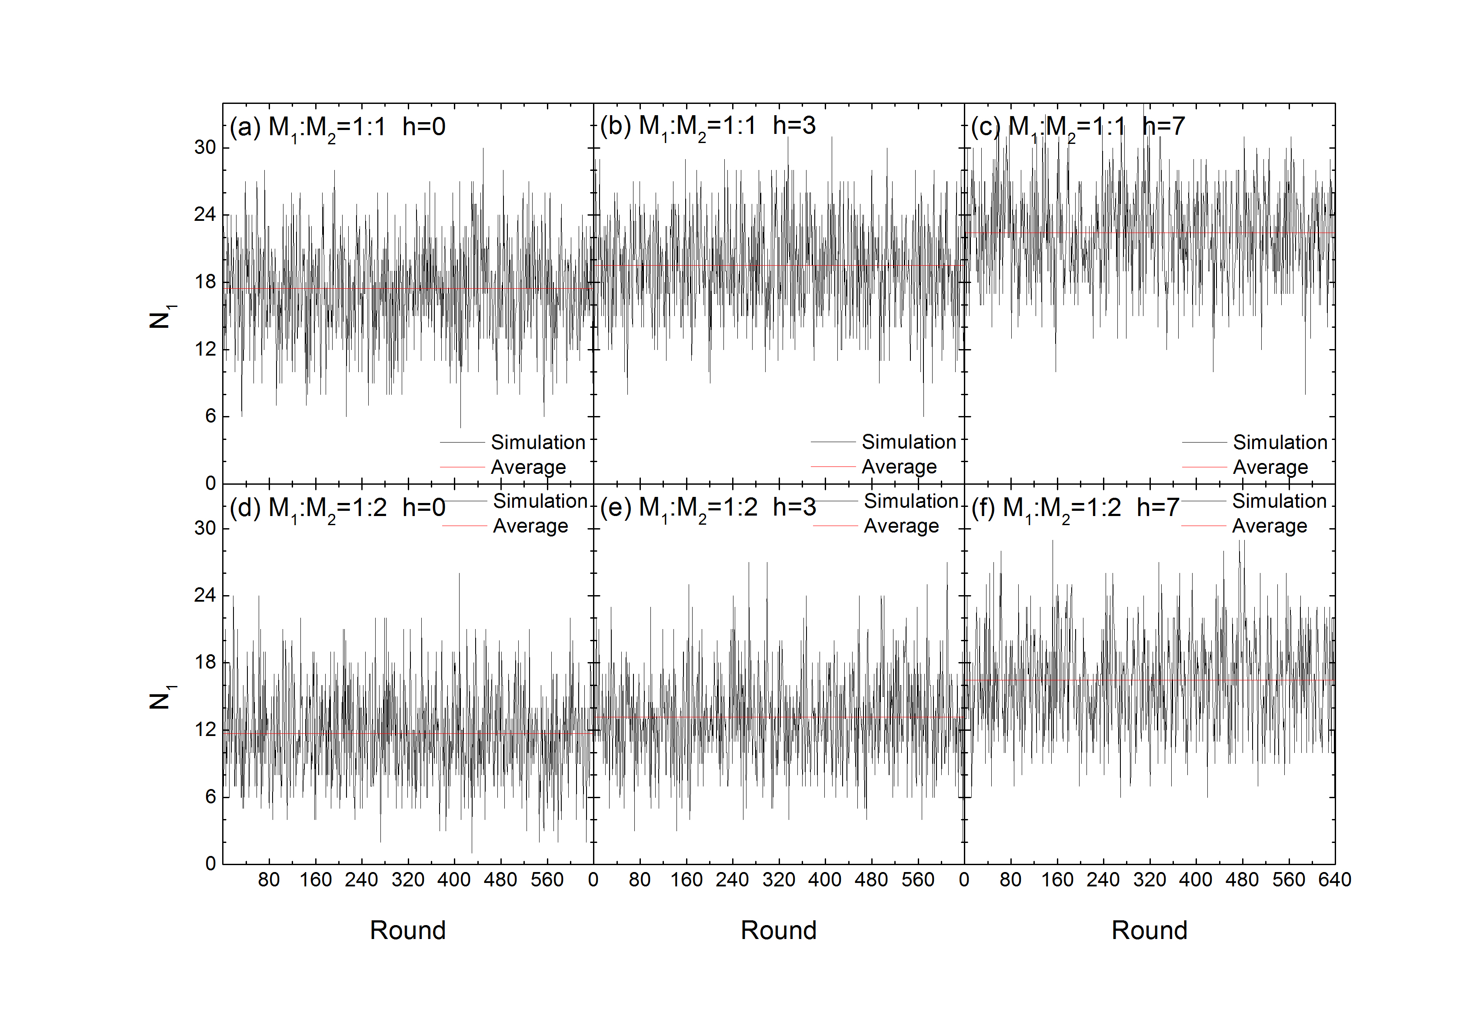
Ising game: Equivalence between Exogenous and Endogenous Factors
Chen Xin, Guang Yang, and Jiping Huang
Department of Physics and State Key Laboratory of Surface Physics, Fudan University, Shanghai 200433, China
Abstract
The positive value of h indicated a preference on Room 1, and vice versa. We conducted 6 sessions of experiments in all, and each session of 20 rounds took about 30 minutes.
Calculation
It is believed that a system will reach an equilibrium state under the power of market, or the so-called "Invisible Hand". However, when influenced by an external force, the system will deviate from the equilibrium state. To illustrate the external force acting on realistic market systems, we designed and conducted a series of human experiments of "Ising Game" based on Ising model and game theory. From the experiments we found that the system will approach a new equilibrium state instead of the original one. To demonstrate the new state is balanced and stable, we further conducted computer simulations and theoretical calculations which gave the same results. We investigated the influence of the external force and resource allocation ratio and found they are transferable. Thus we proved the equivalence between exogenous and endogenous factors of the system and gave a numerical method to calculate the equilibrium state.
To further demonstrate that the system is in the equilibrium state, we calculated the probability of each player entering Room 1 numerically from the concept of game theory. Suppose there are N players and in the equilibrium state the probability of each player entering Room 1 is p. Once we know or set the values of h, m and N, we can get the equation of p.
Results
First, we set M1=M2, and conducted 3 sessions of experiments. For h=0, 3 & 7, the percentage of participants entering Room 1 is 0.504, 0.544 and 0.597, respectively. We can see that N1 fluctuates around a certain value, which becomes larger as the value of h grows larger.
Model
Since m, h and N are known during our experiments, we can calculate the theoretical values of p and compare them with those of the experiments and simulations. We can see that the experimental and theoretical results are extremely close in each session. The simulation results are always a bit bigger due to parameter settings, but still show the same trend.
Social and economic systems as complex systems, interaction between agents
External force influencing the system
The correspondence of Ising model and game theory (spins – players, orientations – strategies, energy – payoff, physical equilibrium – Nash equilibrium)
MDRAG
Summary
By combining Ising model and game theory, we have proposed a new kind of game – Ising game.
This work is useful in financial markets and game theory related fields like evolutionism and economics because it provides numerical results representing the behaviors and factors of systems such as stock markets or the macroscopic economy situation. On one hand, under certain system circumstances, one is able to know whether the system is in the equilibrium state or how seriously it biases this state. On the other hand, the supervisor of the system is able to control the equilibrium state by adjusting the resource allocation or external field to attain certain goals such as stabilizing the stock market, etc.
Still, Potts model and the n-vector model will be introduced in future works which produces more choice to participants to describe the market more accurately. Furthermore, we plan to introduce the mean-field approximation and renormalization group approximation into this work to detect the long-range order behavior in such systems.
This figure shows the experiment results under the condition of M1/M2=1/2. It indicates the same conclusion that if h gets larger, then N1 becomes larger.
To demonstrate the system behavior of such repeated games with an external field, we next conducted 6 computer simulations with the same parameters as those of the human experiments. It can be seen that the trend of the participants’ choices behaves the same as that in the human experiments.
Experiments & Simulations
Introduce market information h
34 students and teachers from the department of physics of Fudan University
The participants were told that they had to make a choice between two rooms in each of the 20 rounds of a session for sharing the different amounts of virtual resource in each room
The participants who went into the relative minority room won the payoff in that round
The payoffs per round was organized as follow:
References:
[1] J. P. Huang, Experimental econophysics: Complexity, self-organization, and emergent properties, Physics Reports, volume 564, 1-55 (2015).
[2] J. P. Huang, Experimental Econophysics: Properties and Mechanisms of Laboratory Markets (Springer, 2015).
Payoffs per round (points) | win | lose
Room 1 | 10+h | h
Room 2 | 10 | 0

