Slide 1
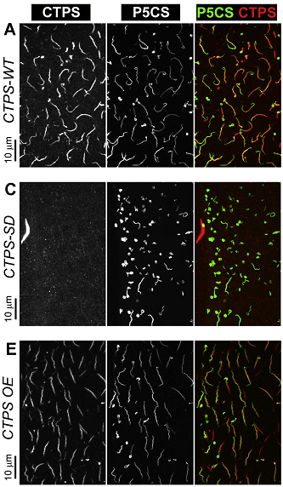
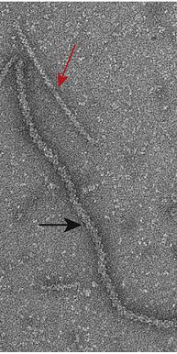
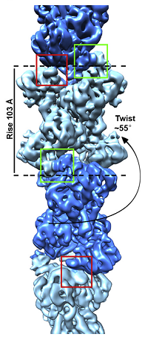
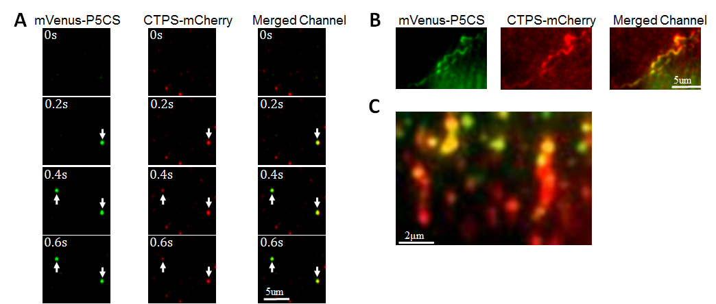
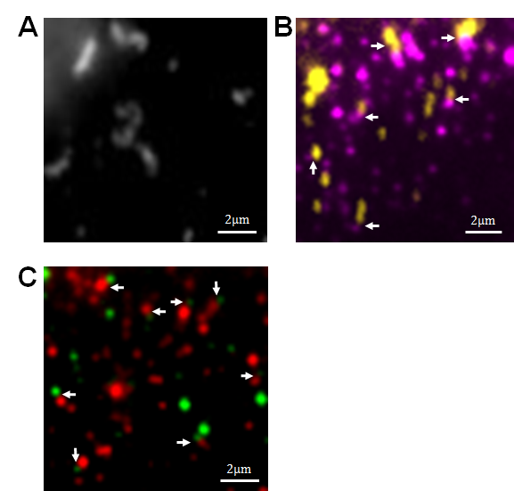
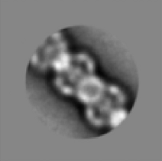
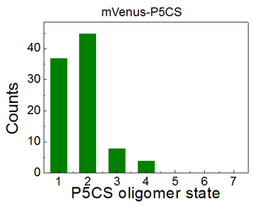
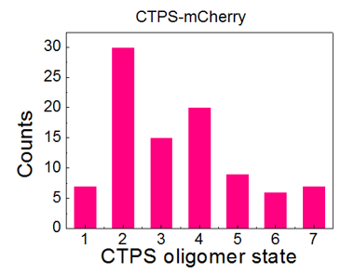
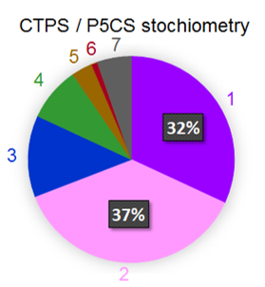
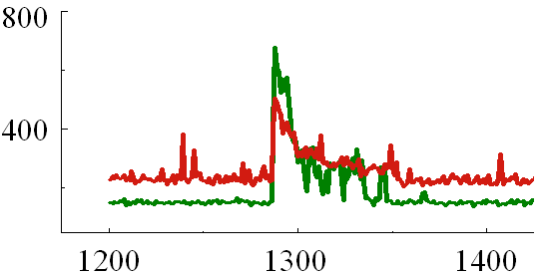
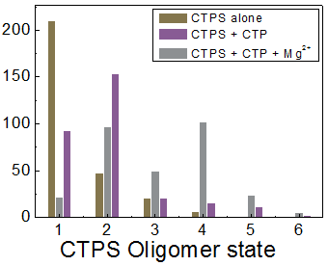
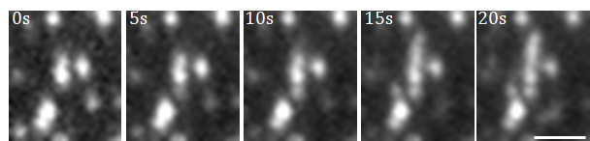
Dynamic Self-assembly Observation of CTP synthase
and P5CS Polymers
Jian Chang*, Weijie Yuan*, Ji-Long Liu†,‡ and Yan-Wen Tan*
*State Key Laboratory of Surface Physics, Department of Physics, Fudan University, Shanghai 200433, China
† MRC Functional Genomics Unit, Department of Physiology, Anatomy and Genetics, University of Oxford, Oxford, OX1 3PT, United Kingdom
‡ School of Life Science and Technology, ShanghaiTech University, Shanghai 201210, China
Introduction
Fluorescence co-localization of CTPS and P5CS filaments in vitro
P5CS
CTPS
(a)
(b)
Figure (a) : Fluorescence co-localization of CTPS (red) and P5CS filaments (green) .
Figure (b) : CTPS filaments (red) elongation along the formed P5CS polymers (green).
Binding stoichiometry of CTPS and P5CS in vitro
(a)
mVenus-P5CS
CTPS-mCherry
Merged Channel
(c)
Zhou, X, et al. J Genet Genomics 46, 537–545 (2019).
Zhang, B, et al. J Genet Genomics 47, 131–143 (2020).
CTP synthase (CTPS) is an essential metabolic enzyme. It catalyses CTP production from UTP, ATP, glutamine and acts as an attractive target for various cancer and parasitic diseases in drug development. It can polymerize into “Cytoophidia” alone or co-localize with another kind of metabolic enzyme filaments, P5CS.
(d)
(d)
Results
Self-assembly observation of CTPS and P5CS filaments in vitro
(e)
CTPS
mCherry
mVenus
P5CS
(b)
(a)
0s
(b)
Counts
Frames
5s
Figure (a) : In vitro dynamic binding of CTPS and P5CS.
Figure (b) : Fluorescence intensity trajectory of bound CTPS and P5CS.
Figure (c-d) : Oligomer state statistics of bound P5CS (c) and CTPS (d).
Figure (e) : Binding stochiometry analysis of bound of CTPS and P5CS.
10s
(c)
Conclusions
15s
The dynamic self-assembly CTPS and P5CS in vitro were observed by total internal reflection fluorescence microscopy (TIRFM).
CTPS " Cytoophidia " could co-localize with P5CS filaments and elongate along formed P5CS polymers.
Binding stochimetry of CTPS and P5CS was analyzed.
20s
Figure (a) : Dynamic self-assembly of CTPS filaments.
Figure (b) : Oligomer state statistics of CTPS under different conditions during self-assembly.
Figure (c) : Elongation (yellow parts) of P5CS filaments (magenta parts).

