Slide 1

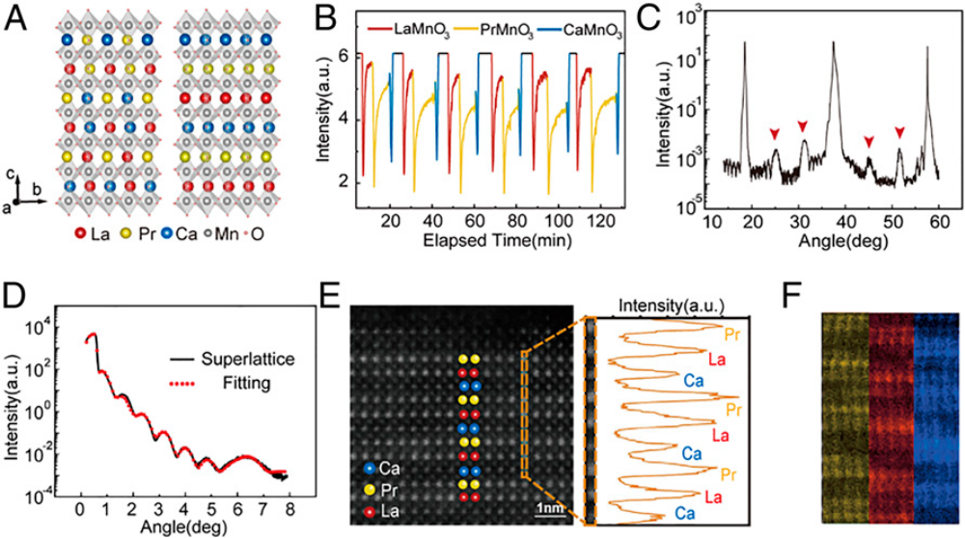
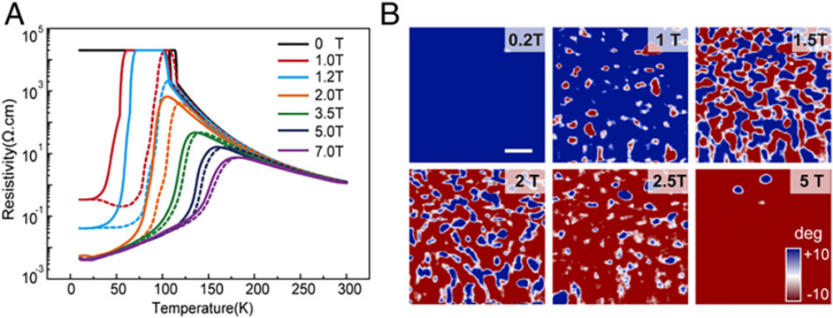
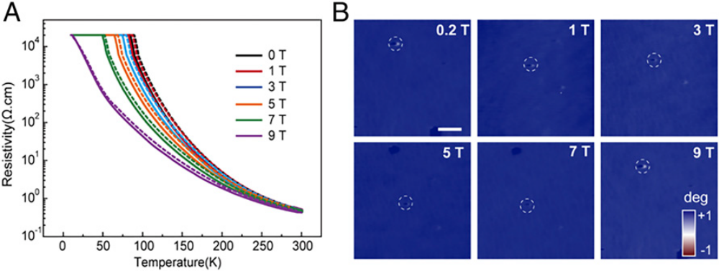
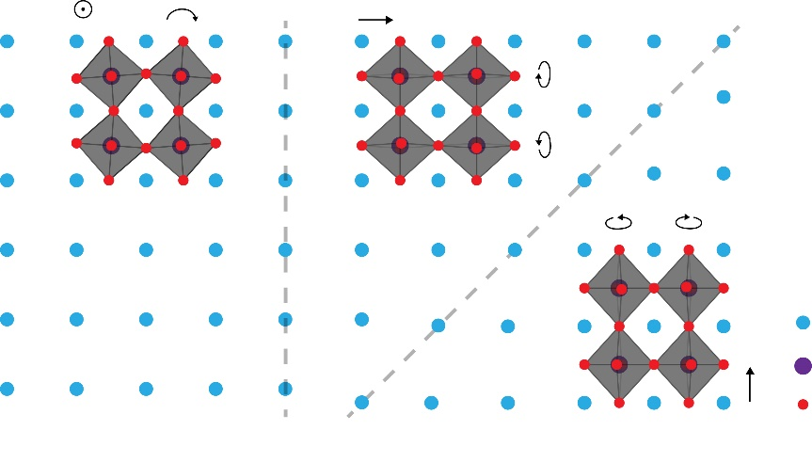
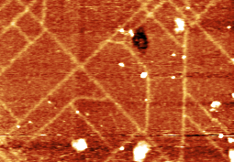
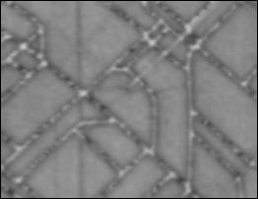
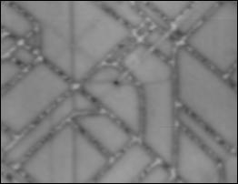
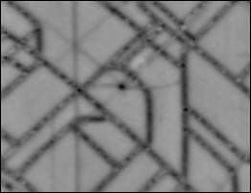
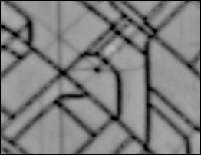
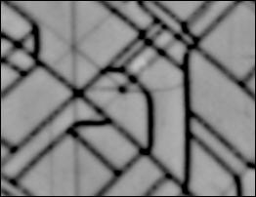
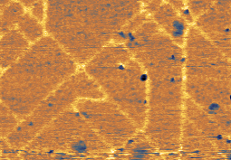
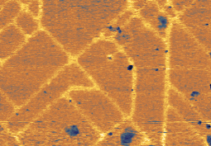
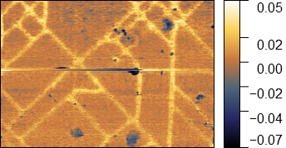
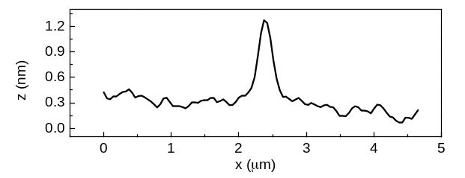
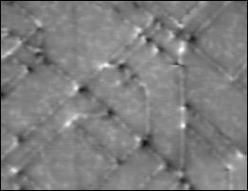
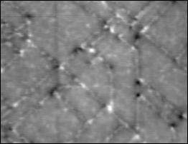
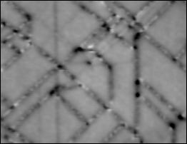
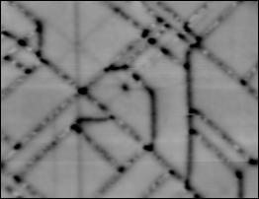
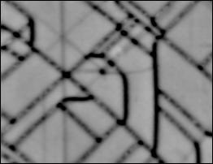
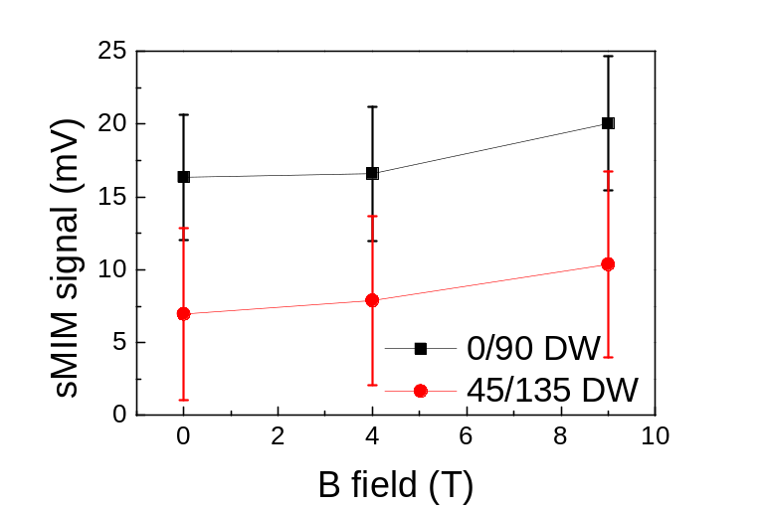
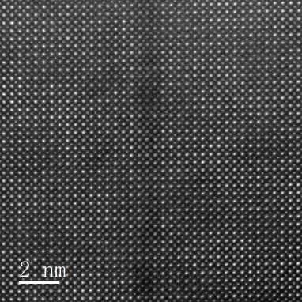
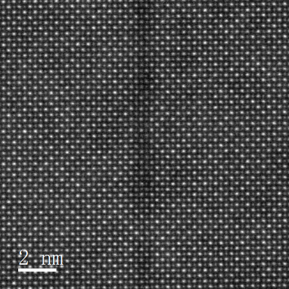
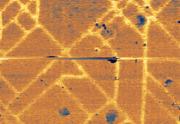
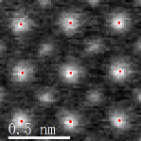
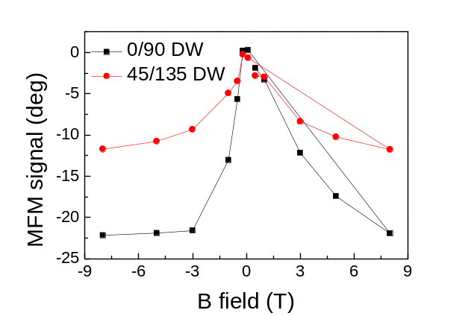
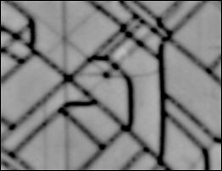
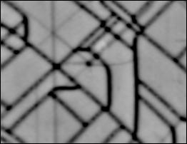
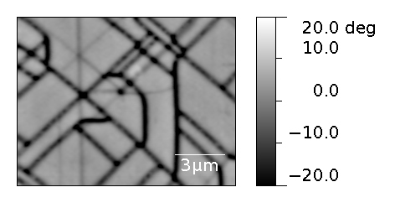
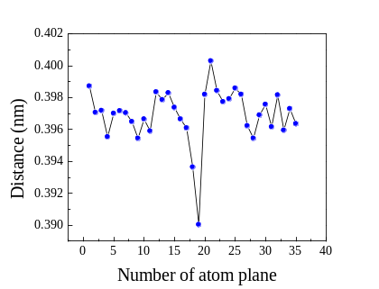
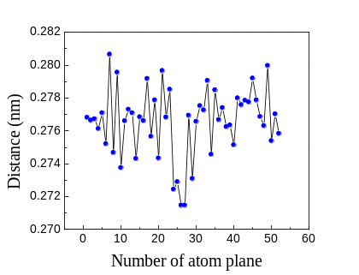
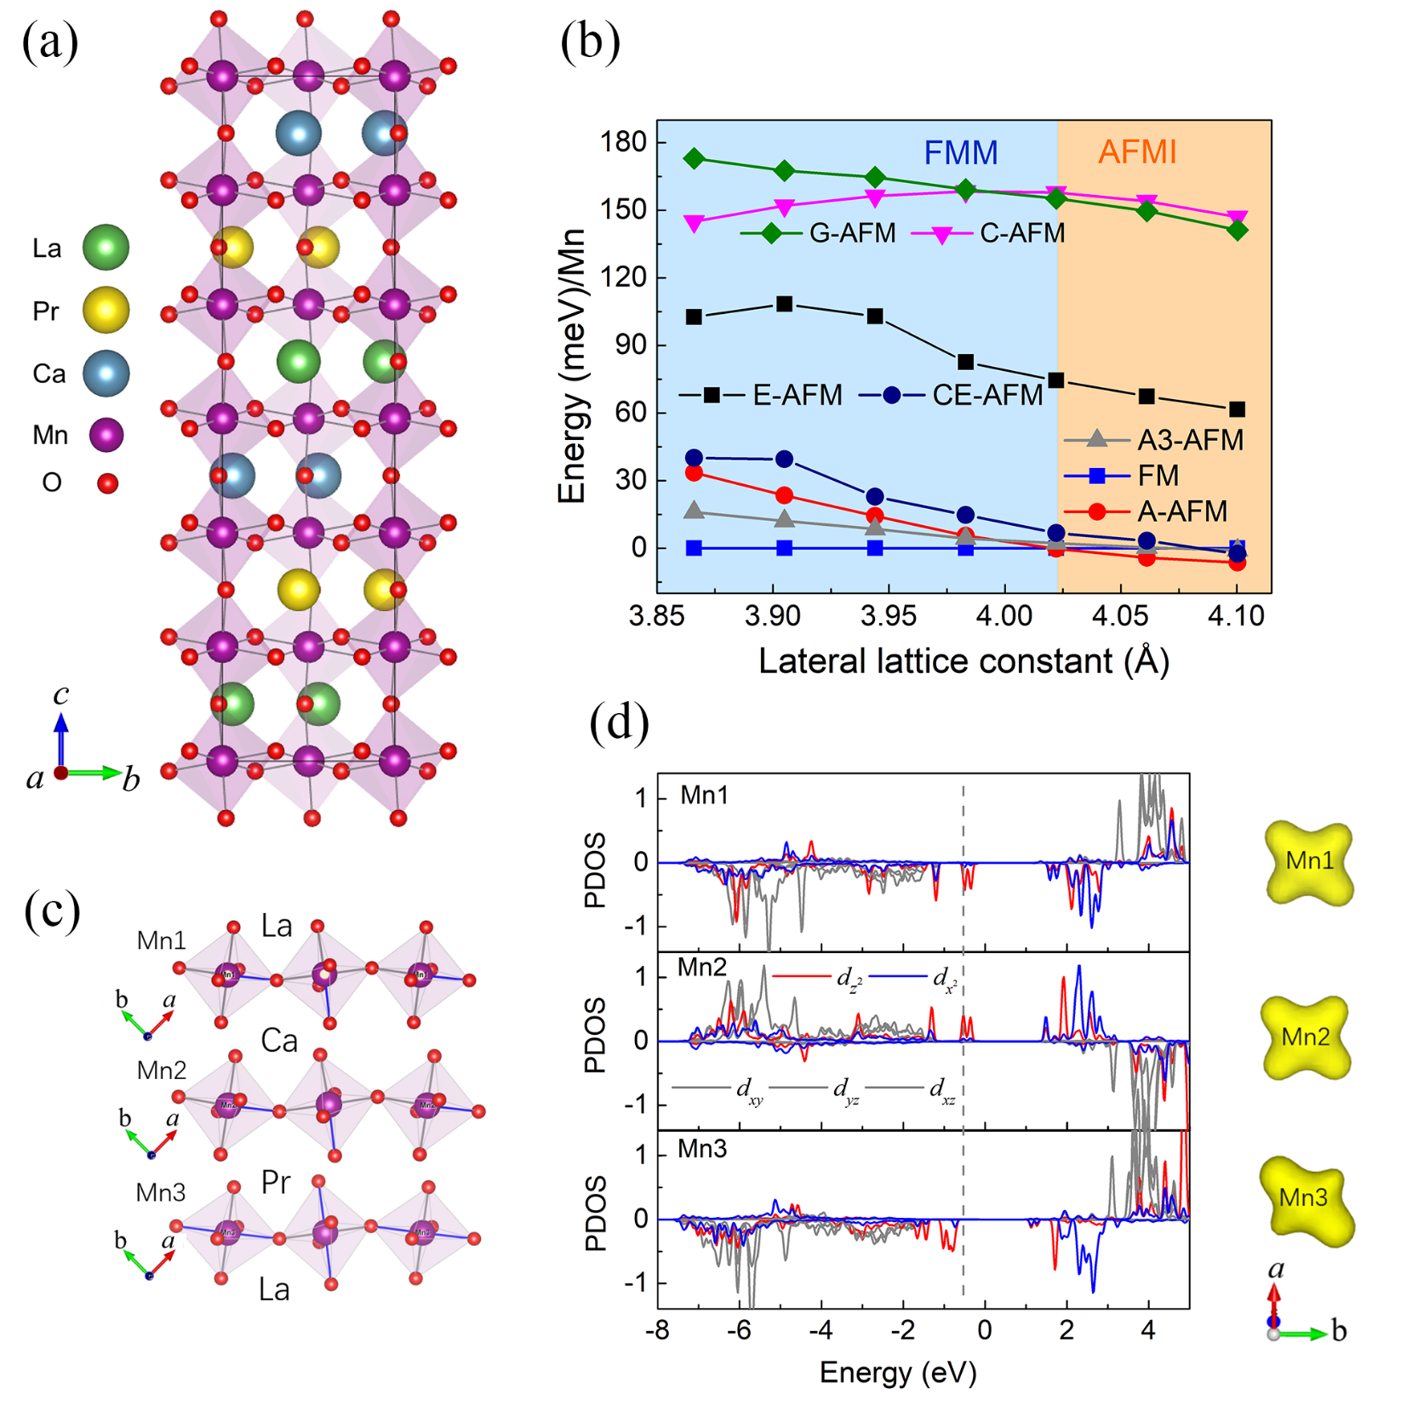
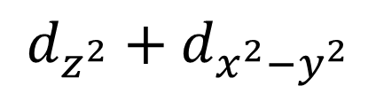

ANNUAL ACADEMIC CONFERENCE 2022
Electronically phase separated nano-network in antiferromagnetic insulating LaMnO₃/PrMnO₃/CaMnO₃ tricolor superlattice
Qiang Li^{1,2}*, Tian Miao^{2,4}*, Huimin Zhang^{2,3,7}*, Weiyan Lin¹, Wenhao He^{1,2}, Yang Zhong^{2,3,7}, Lifen Xiang², Lina Deng², Biying Ye², Qian Shi², Yinyan Zhu^{1,7,8}, Hangwen Guo^{1,7,8}, Wenbin Wang^{1,7,8}, Changlin Zheng^{1,2}, Lifeng Yin^{1,2,5,6,7,8}, Xiaodong Zhou^{1,7,8†}, Hongjun Xiang^{2,3,7†} and Jian Shen^{1,2,5,6,7,8†}
¹State Key Laboratory of Surface Physics and Institute for Nanoelectronic Devices and Quantum Computing, Fudan University, Shanghai 200433, China
²Department of Physics, Fudan University, Shanghai 200433, China
³Key Laboratory of Computational Physical Sciences (Ministry of Education) and Institute of Computational Physical Sciences, Fudan University, Shanghai 200433, China
⁴School of Materials Science and Engineering, Xi’an Jiaotong University, Xi’an, Shanxi 710049, China
⁵Shanghai Research Center for Quantum Sciences, Shanghai 201315, China
⁶Collaborative Innovation Center of Advanced Microstructures, Nanjing 210093, China
⁷Shanghai Qi Zhi Institute, Shanghai 200232, China
⁸Zhangjiang Fudan International Innovation Center, Fudan University, Shanghai 201210, China
R-LPCMO
O-LPCMO
Background
MFM
EPS network
3 GHz
Magnetic force microscopy(MFM)
——Magnetism
Scanning Microwave Impedance Microscopy (sMIM)
——Conductivity
sMIM
SrTiO₃ domain walls
R-LPCMO with EPS
c
c
Electronic phase separation(EPS)
Ferromagnetic metallic state(FMM)
Antiferromagnetic charge-ordered insulator (AFM-COI)
Sr
c
Ti
O-LPCMO without EPS
STO structural transition
O
AFM
[010]
Result
0.5T
(a)
1T
(b)
3T
(c)
5T
(d)
8T
(e)
(a)
0T
(b)
4T
50 mV
20
2 μm
0
2 μm
-20
[100]
2 μm
-40
0.1T
(f)
-0.2T
(g)
-0.5T
(h)
-1T
(i)
-3T
(j)
(c)
(d)
-70
STEM
0° DW
45° DW
9T
-5T
(k)
-8T
(l)
15 deg
(m)
[010]
[110]
10
5
[100]
[1-10]
0
sMIM image (2K)
[001]
[001]
-5
-10
-15
0°/90°——FMM state
45°/135°——EPS state
Compressive strain
MFM image (12K)
(a)
Density Functional Theory calculation
(b)
(c)
(d)
$$d_{z^{2}}+d_{x^{2}−y^{2}}$$
$$d_{z^{2}}$$
Jahn-Teller distortion
PDOS and charge density in A-AFM state
Conclusions
EPS nano-network triggered by the structural domain formation of the underlying STO
One-to-one correspondence between ferromagnetic (AFM) to metallic (insulating) state in manganite
Reference:
Miao, T. et al. Direct experimental evidence of physical origin of electronic phase separation in manganites. PNAS 117, 7090-7094 (2020).
Li, Q. et al. Electronically phase separated nano-network in antiferromagnetic insulating LaMnO₃/PrMnO₃/CaMnO₃ tricolor superlattice. Nature Communications 13, 6593 (2022).

