Slide 1


Problem 4
Liquid Film Motor
郭学菲
Natural Science
14307110257
tutor：乐永康，徐建军

Slide 2
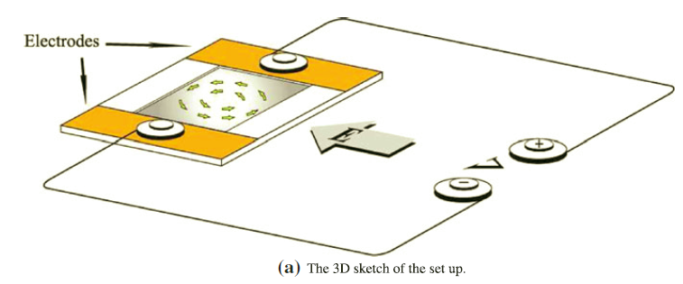
Form a soap film on a flat frame. Put the film in an electric field parallel to the film surface and pass an electric current through the film. The film rotates in its plane. Investigate and explain the phenomenon.
Reference:
R. Shirsavar, A. Amjadi, A. Tonddast-Navaei , &M. R. Ejtehadi(2011) Electrically rotating suspended films of polar liquids Exp Fluids 50:419–428

Slide 3
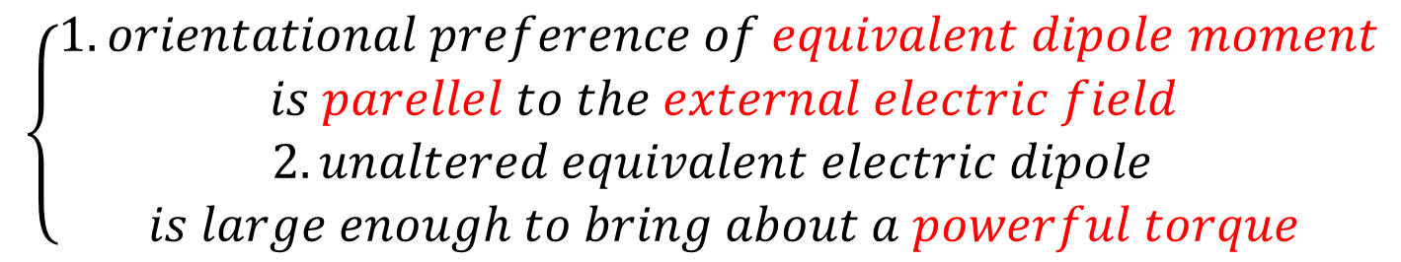
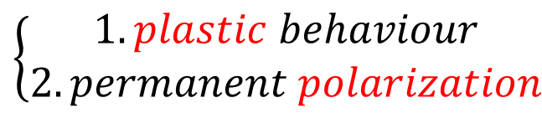
deduction 1
model 1
1.quasi-two-dimensional space
2.quantum field theory in favor of
$$\left\{\begin{aligned}1.plastic behaviour \\ 2.permanent polarization\end{aligned}\right.$$
$$\left\{\begin{aligned}1.orientational preference of equivalent dipole moment \\ is parellel to the external electric field \\ 2.unaltered equivalent electric dipole \\ is large enough to bring about a powerful torque\end{aligned}\right.$$
Reference:
Zhong-Qiang Liu, Ying-Jun Li, Guang-Cai Zhang, & Su-Rong Jiang (2011) Dynamical mechanism of the liquid film motor PHYSICAL REVIEW E 83, 026303(1-7)

Slide 4
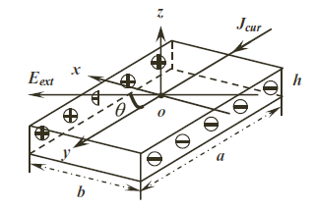

Slide 5
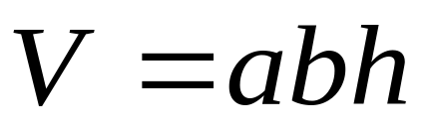
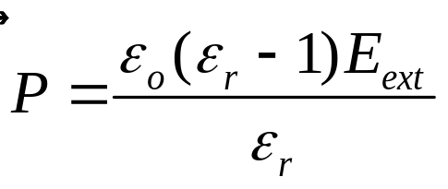
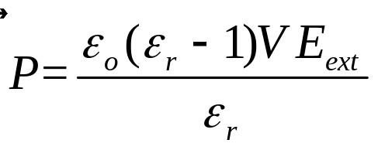
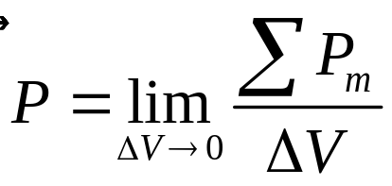
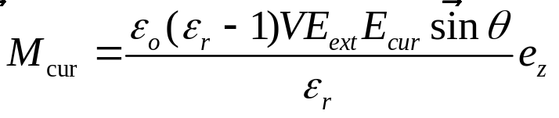
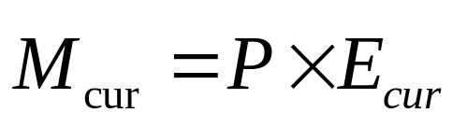
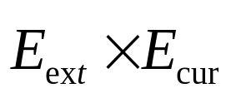

Remark:
1.rotation direction:
2. could be applied to arbitrary shape by extrapolation

Slide 6
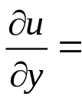
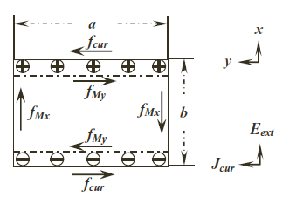
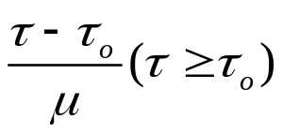
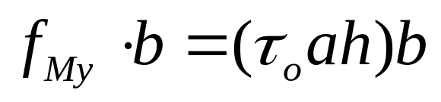
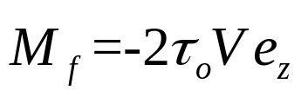
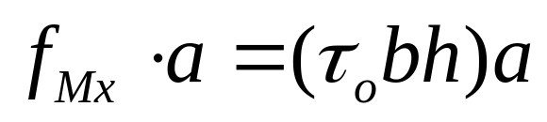
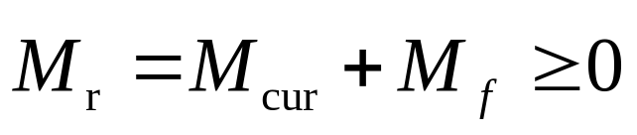
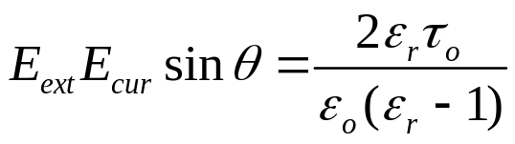

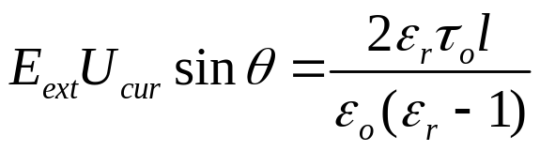



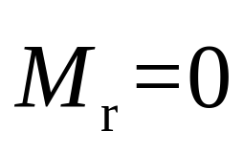

0 （$τ＜τo）$
plastic fluid:
Remark: is the threshold of fields

Slide 7
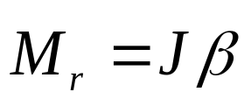
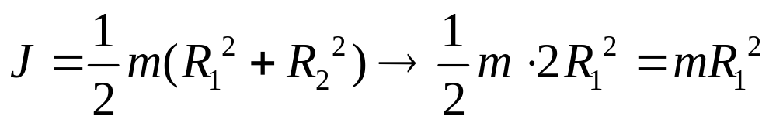
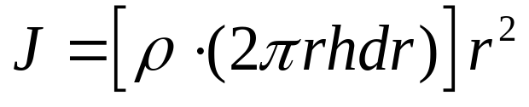

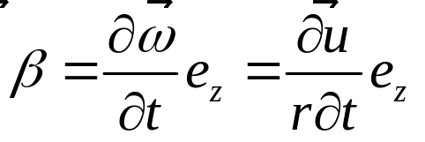
deduction 2
model 2
a series of concentric cylindrical rings
namely
Reference:
R. Shirsavar, A. Amjadi, A. Tonddast-Navaei , &M. R. Ejtehadi(2011) Electrically rotating suspended films of polar liquids Exp Fluids 50:419–428

Slide 8
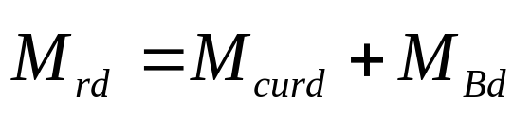
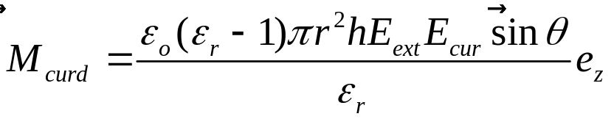
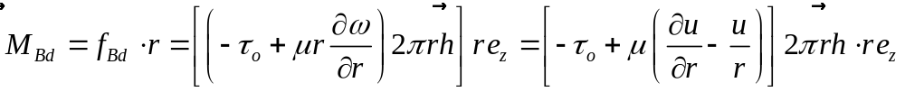
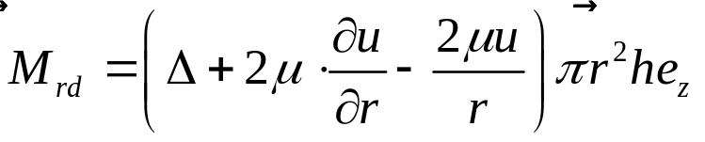
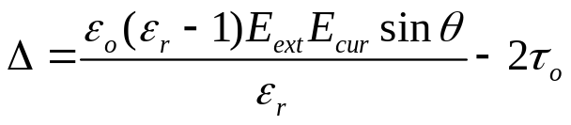
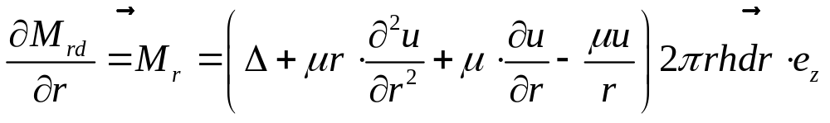
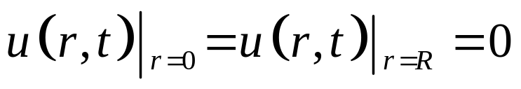
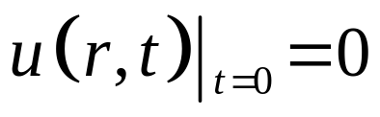
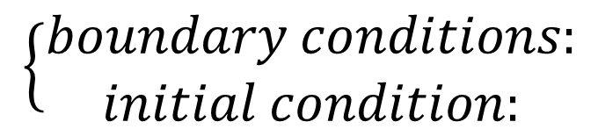
on a disc liquid film
&
$$\left\{\begin{aligned}boundary conditions: \\ initial condition:\end{aligned}\right.$$

Slide 9
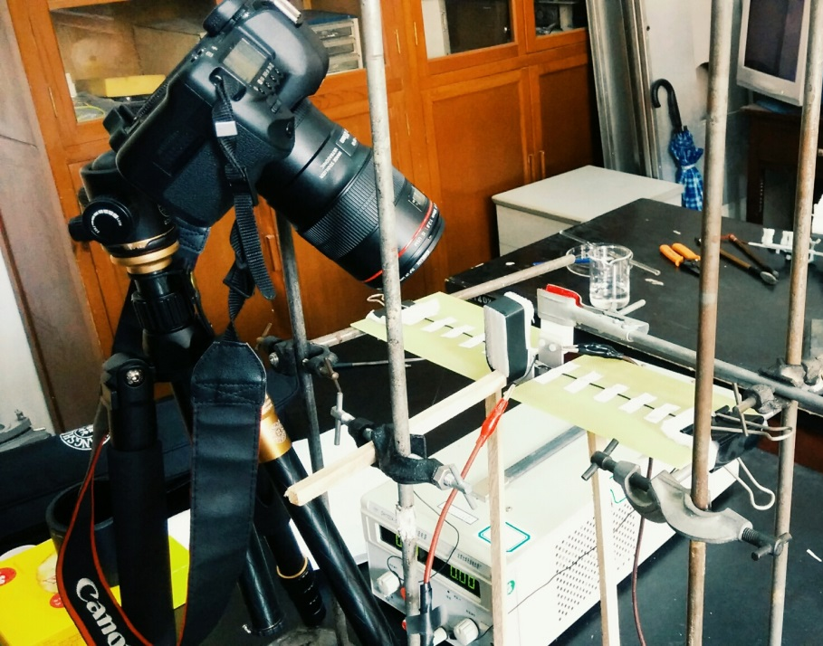
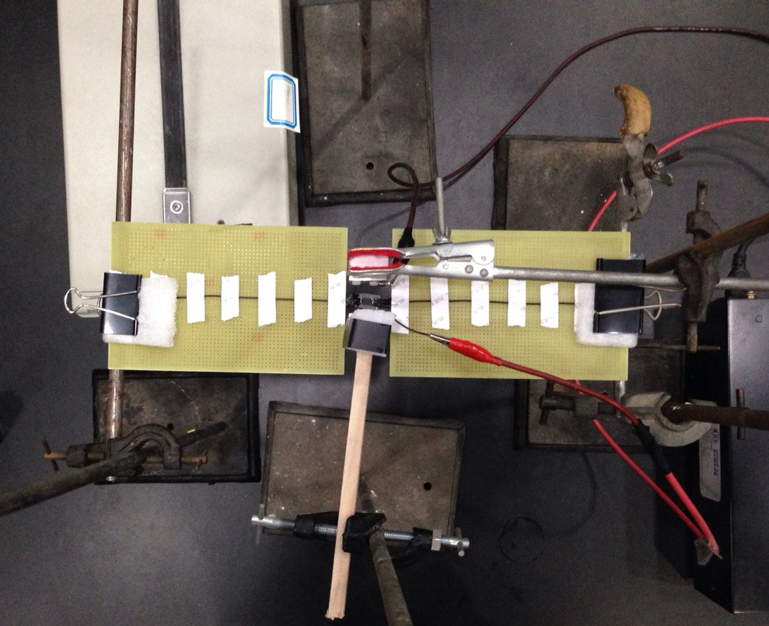
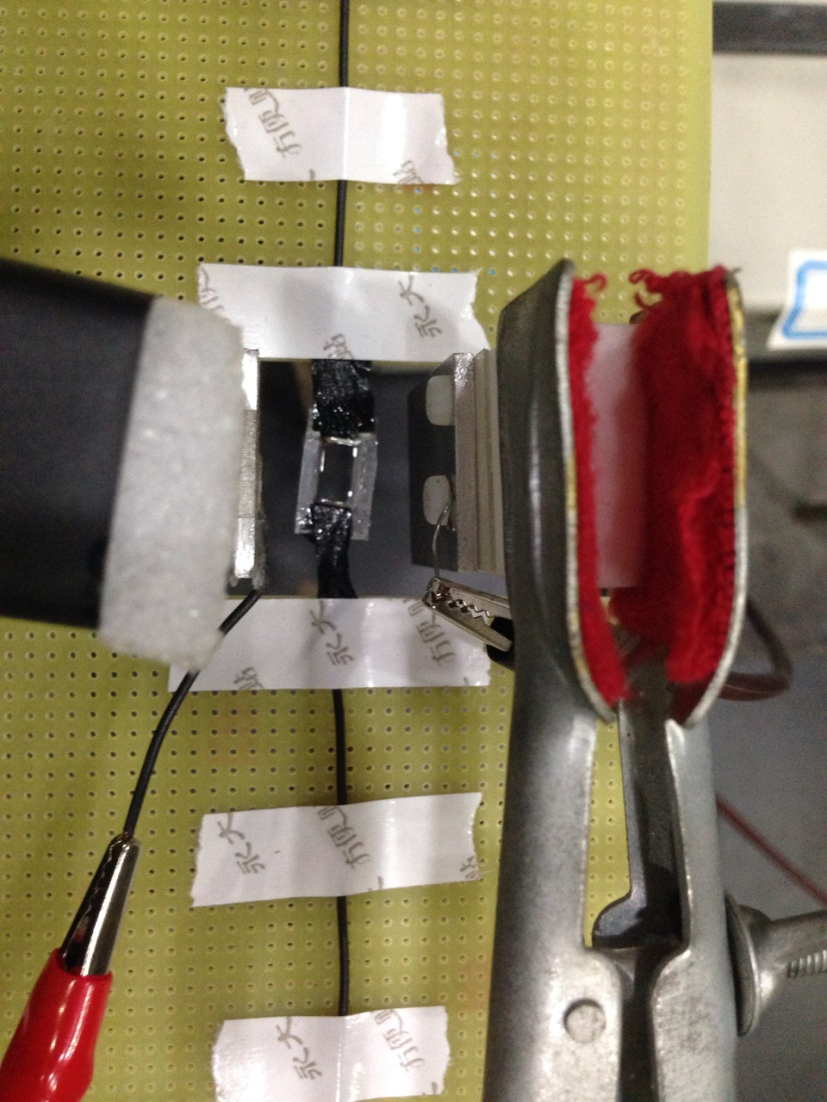

set-up 1
平行板电容器
plastic frame: 0.870*0.580*0.070cm³(0.966*1.670*0.070cm³)
plane-parallel capacitor(made of aluminum):
2.468*3.418 cm² & 2.500*3.450cm² distance:3.144cm
ordinary blank printed circuit board distance: 3.180cm
DC power supply 1: 北京大华无线电仪器厂 DH1722A-5 0-300V 0-1A
DC power supply 2: BOHER HV 72030P 0-20kV 30W
Glycerin volume fraction:30%/40%
Canon EF 100mm f/2.8 USM

Slide 10
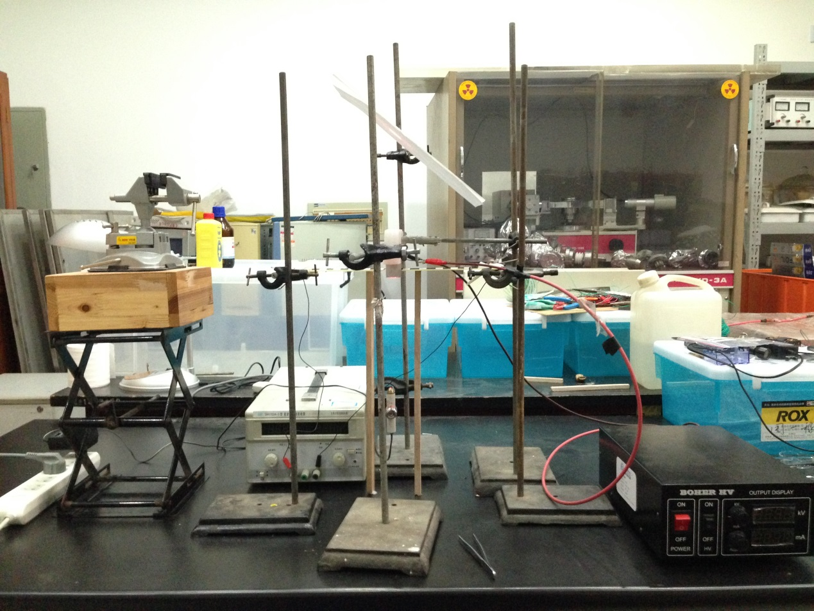
set-up 2

Slide 11

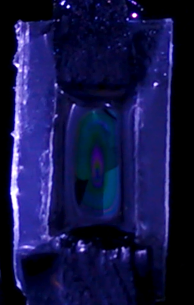
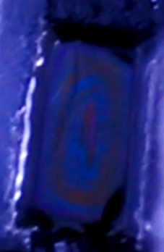
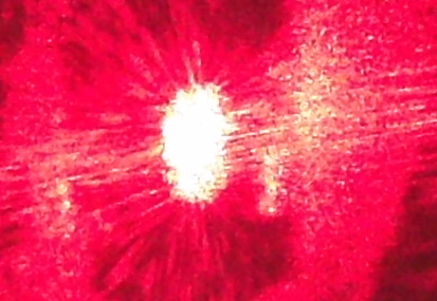
experiment video
video

Slide 12
experiment data 1
acquired by using red laser
U_{cur}/V | U_{ext}/kV | phenomenon | remark | U_{cur}*U_{ext}
80 | 0.34 | start |  | 27.2
 | 0.76 | obvious | total
60 | 0.22 | start | fuzzy | 13.2
 | 0.46 | start |  | 27.6
60 | 0.44 | start |  | 26.4
 | 0.48 | obvious | total
40 | 0.58 | start |  | 23.2
 | 0.8 | obvious | total
20 | 0.84 | start |  | 16.8
 | 0.9 | obvious | total
10 | 1.37 | start |  | 13.7
 | 2.04 | no rotation
 | 3.03 | no rotation
 | 1.38 | no rotation
 | 1.42 | no rotation
10 | 1.45 | no rotation |  | 14.5
shows U_{cur}*U_{ext}=constant

Slide 13
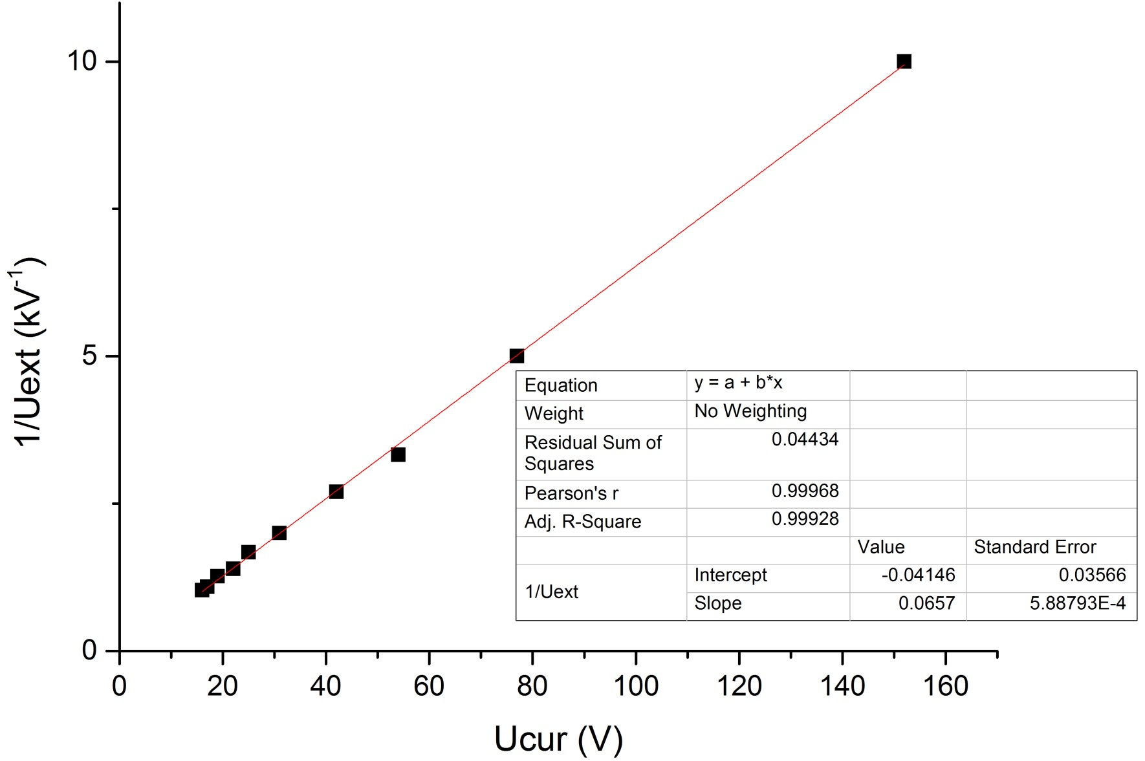
experiment data 2
acquired by natural light
Glycerin volume fraction:30%

Slide 14
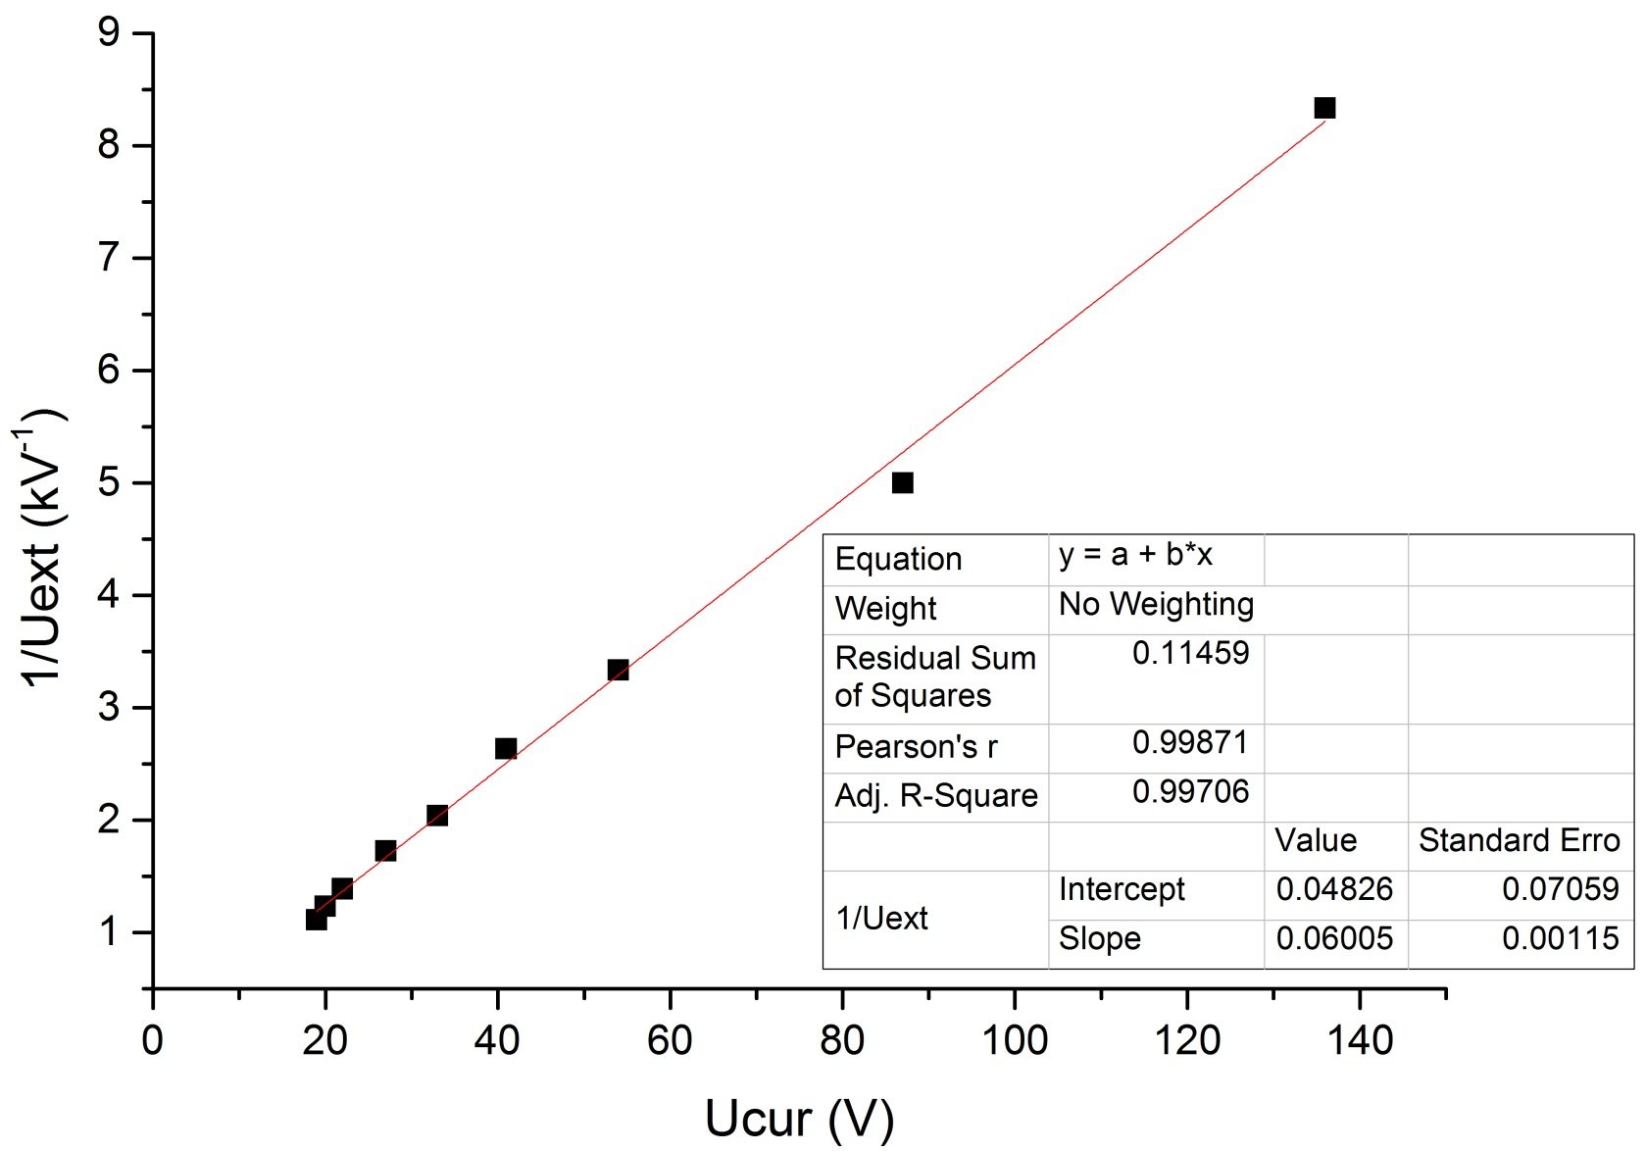
experiment data 2
Glycerin volume fraction:40%
more data need to be acquired in the following experiments.

Slide 15
conclusion
threshold: Ucur*Uext = constant

Slide 16
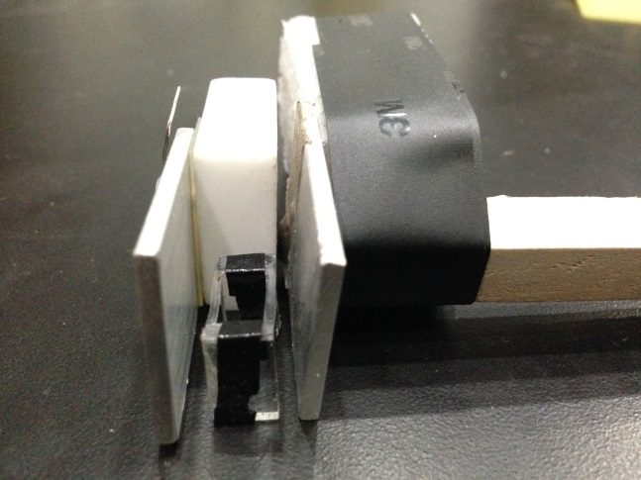
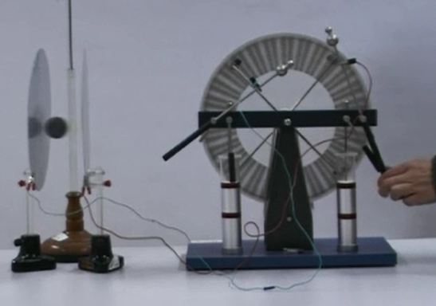
difficulties
1.Safety:
frame is attracted to the positive pole
frame with liquid film：
U=2.50kV I=0.002mA discharge accompanied with sound

Slide 17
difficulties
without frame:
U/kV | I/mA
4.00 | 0.004
5.00 | 0.005
U=5.00kV I=0.005mA discharge doesn’t appear

Slide 18
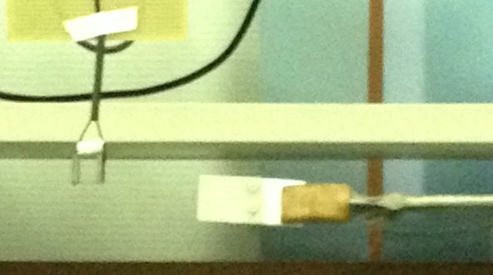
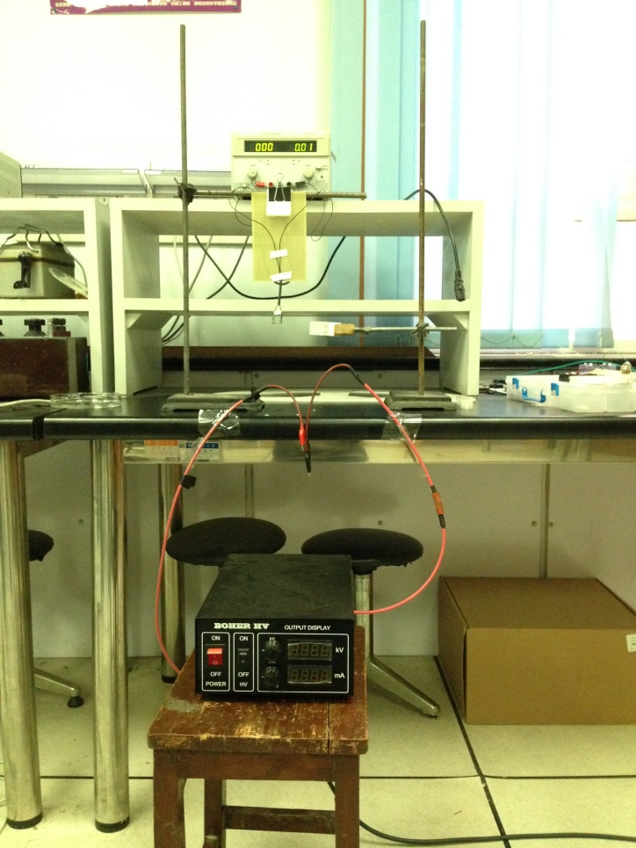
frame without liquid film:
U/kV | I/mA
1.00 | 0
1.50 | 0
2.00 | 0.002
2.50 | 0.002
3.00 | 0.004
3.24 | 0.003
3.50 | 0.003~0.004
3.80 | 0.005
4.00 | 0.004~0.005
4.60 | 0.004
U=4.6kV I=0.004mA discharge accompanied with sound
back to U=3.5kV discharge disappear

Slide 19
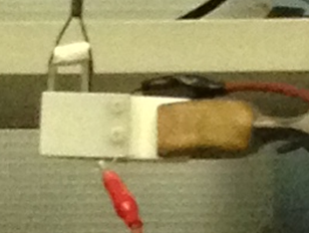
frame without liquid film（plastic plat(PVC) between frame and positive pole）
U/kV | I/mA
2.00 | 0.001~0.002
2.70 | 0.003
2.80 | 0.004
2.90 | 0.005
3.16 | 0.003
3.60 | 0.003
4.00 | 0.004
4.50 | 0.004
5.00 | 0.005
U=5.00kV I=0.005mA discharge doesn’t appear

Slide 20
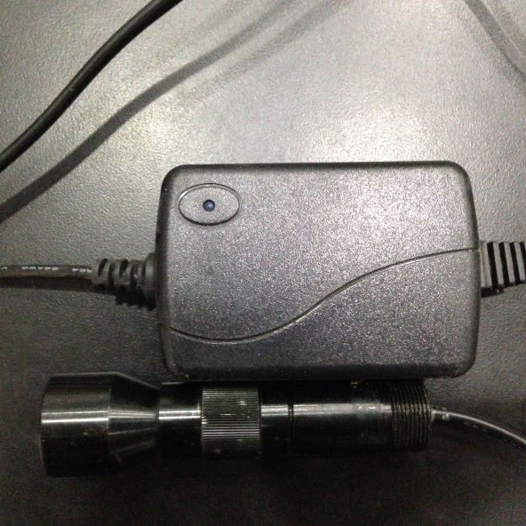
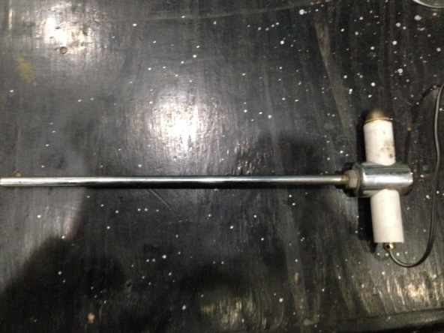



2.observing and charting the phenomenon

Slide 21




Slide 22





Slide 23




3.stability and thickness of the liquid film
glycerinum
ethyl acetate
glycol
propylene glycol

Slide 24
3.data analysis

Slide 25
Following work
1. improve the setup to acquire clearer films
2. acquire more data of the threshold
3. analysize data of the angular velocity by tracker
4. COMSOL simulate
5. imilar experiments on AC fields

Slide 26




more on http://phylab.fudan.edu.cn/doku.php?id=course:interesting_problems:2015:topic4:start

Slide 27
reference
· Zhong-Qiang Liu, Ying-Jun Li, Guang-Cai Zhang, & Su-Rong Jiang (2011) Dynamical mechanism of the liquid film motor PHYSICAL REVIEW E 83, 026303(1-7)
· R. Shirsavar, A. Amjadi, A. Tonddast-Navaei , &M. R. Ejtehadi(2011)
Electrically rotating suspended films of polar liquids
Exp Fluids 50:419–428

Slide 28
appreciation
· appreciate my tutors 乐永康 徐建军 on the assistance of the project
· appreciate 王瀚 林思雨
· appreciate seniors in the lab and others who have helped me in the project

Slide 29

Thank you
For listening
Presented by Jeff, GuoXuefei

