Slide 1

Growth of YBCO and its Superconductivity Research
Dept. of Physics, Fudan University
10301030038 黄梓灿
10300290011 张 建
Supervisor: 姚红英

Slide 2
Outline
Motivation and Basics
Experimental
High-light of the Problems
Future Work

Slide 3
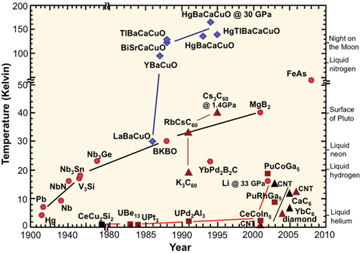
Motivation and Basics
April,1986, Georg Bednorz and Karl Müller: certain semiconducting oxides became superconducting at relatively high temperature
1987, Nobel Prize for Bednorz and Müller
1987, M.K. Wu, Paul Chu, Ashburn and Torng: YBCO , T_{c} of 93 K(first sample-Y_{1.2}Ba_{0.8}CuO₄₎
□ History of Superconducting Materials
(fig_1:http://en.wikipedia.org/wiki/Superconductivity)

Slide 4
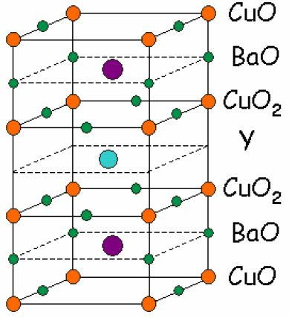
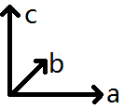
1.About YBCO
1.oxygen deficient layer above
2.Δ=0.32 nm:
current flows on the two CuO2 planes
3.The distance between the copper atoms in these planes makes it easier for charge to hop between ions than from plane to plane——the current flow in a sample is affected by the orientation
a=0.382 nm; b=0.389 nm; c=1.168nm
(fig_2:Resistance of the Superconducting Material YBCO, California Polytechnic State University)

Slide 5
2.How to Make YBCO?
For YBCO to be superconductive, it needs to have a chemical formula of YBa2Cu3O6+y where y is more than 0.5 and less than 1.0
This is what we are interested in!
(#:Resistance of the Superconducting Material YBCO, California Polytechnic State University)

Slide 6
Experimental Design
Growth of YBCO(with Oxygen 0.8L/min, 0.7 L/min, 1.0L/min)
Tc measurement of different samples
XRD research on the samples——show what will happen as y changes
Get better technological parameters of growing YBCO

Slide 7
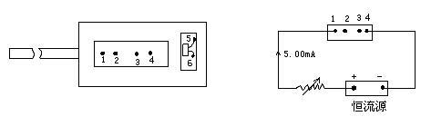
Experimental
1.equipment:
high T furnace, Oxygen, Y2O3(99.99%), CuO(CP), and BaCO3(CP)
2.procedure:
Mix up all the powders
Anneal the mixture in air
Make the powders int pellets
Anneal in Oxygen
Measure Tc
Growth of the sample

Slide 8
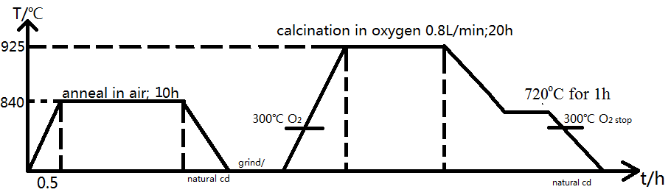
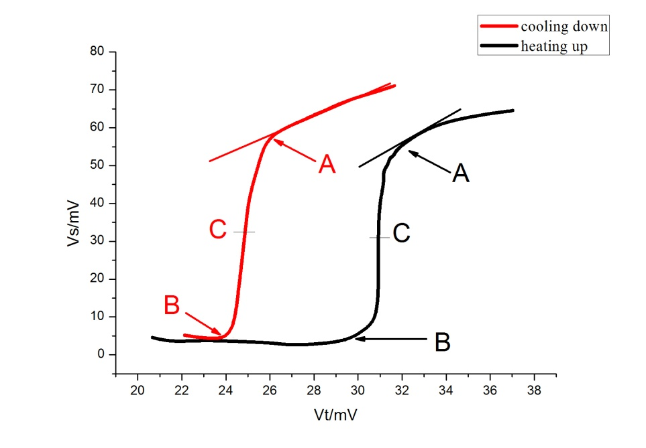
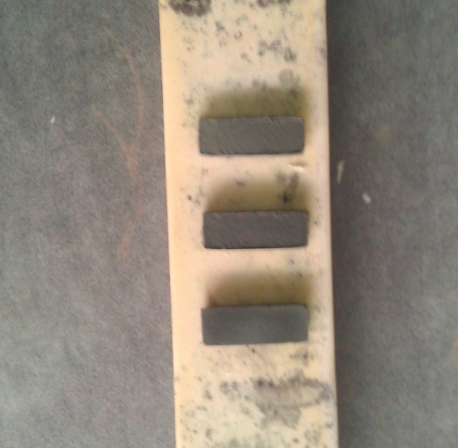
3. Samples with different parameters
Cooling down: Tc=90K;ΔT=4K
Heating up: Tc=98K;ΔT=2K

Slide 9

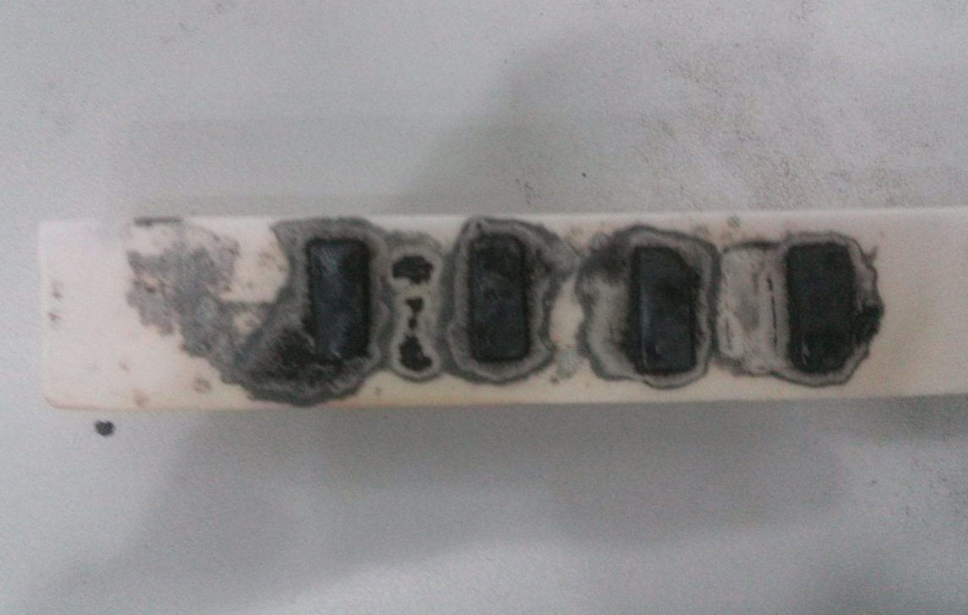
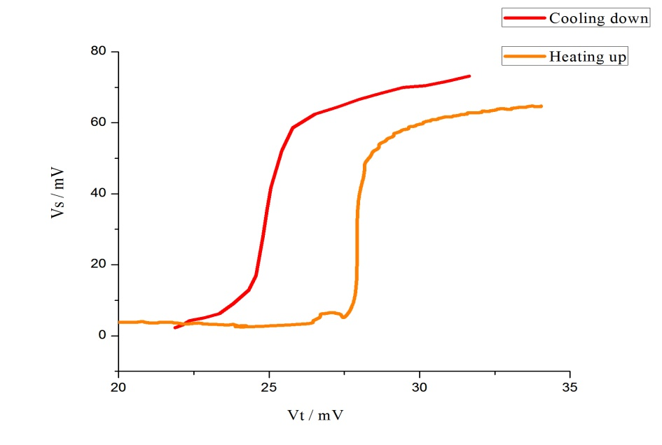
3. Samples with different parameters
Shiny
Cooling down: Tc=91K;ΔT=3K
Heating up: Tc=95K;ΔT=2K

Slide 10
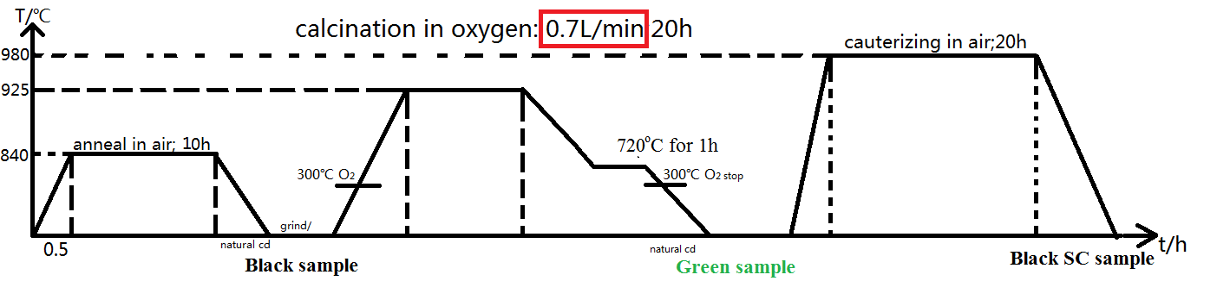
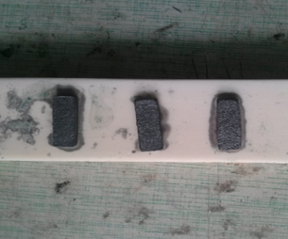
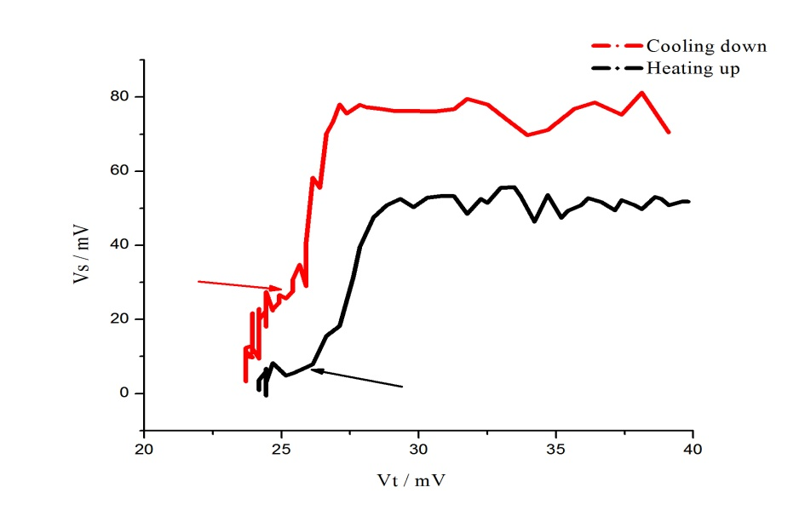
3. Samples with different parameters
Shiny
Cooling down: Tc=92K;ΔT=1K
Heating up: Tc=94K;ΔT=3K

Slide 11
There’s plenty of problems occurred during our experiment.
What we have:
XRD, millions of papers, and most importantly,
Analysis based both on experiment and theory!

Slide 12
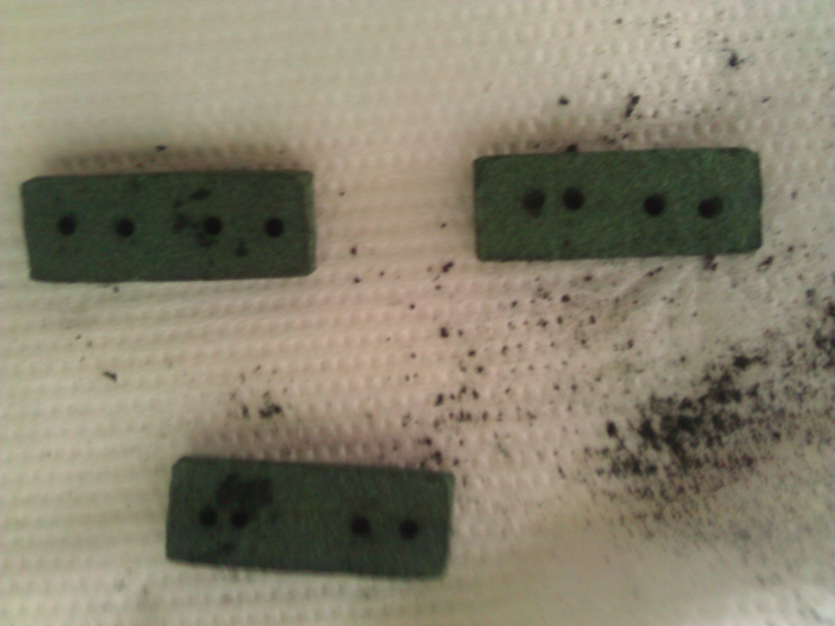
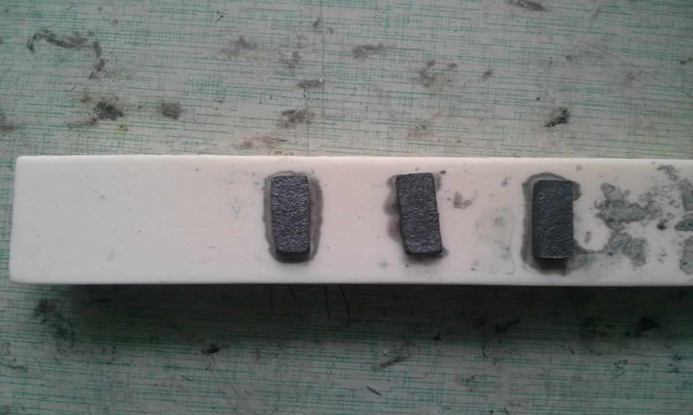
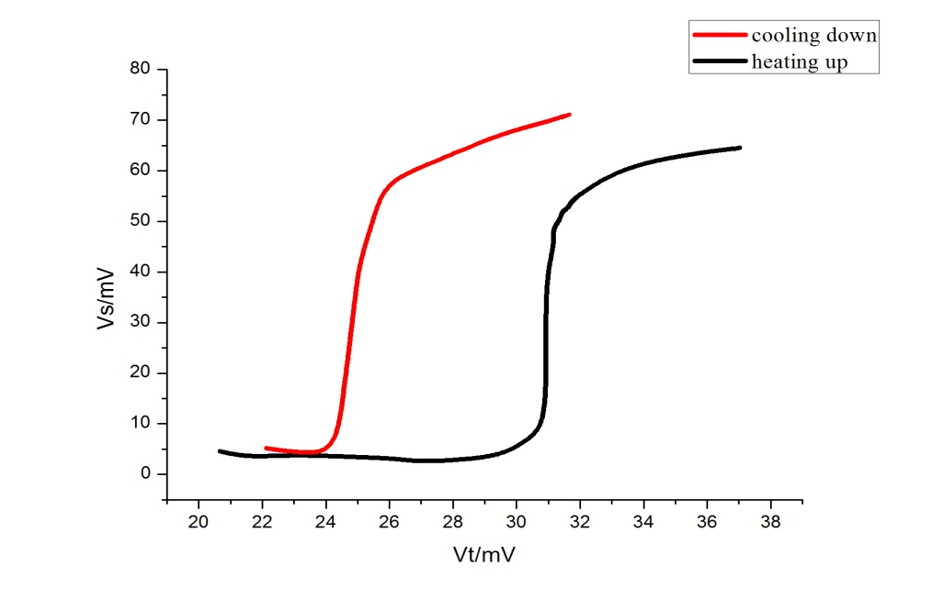
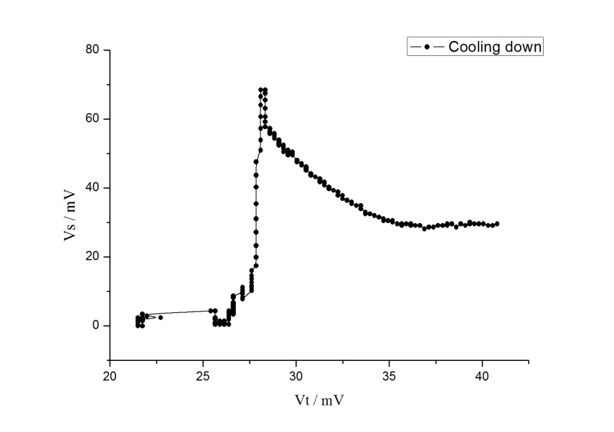
4. New Problems Arise
What’s the green component on the samples?
Did we get single crystal? Can we transit the nonsuperconducting phase into superconducting phase？
Why there’s difference between Tc curve of Heating up and Cooling down?
Why the resistance become higher as T gets lower?
Another sample.
Coincidence ?

Slide 13
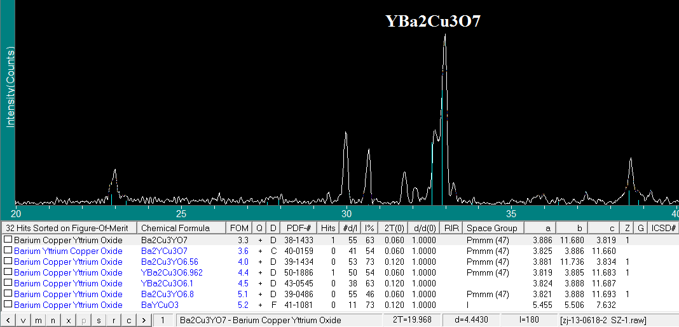

XRD shows what happened to the samples with green components
the XRD result of the black superconducting sample

Slide 14
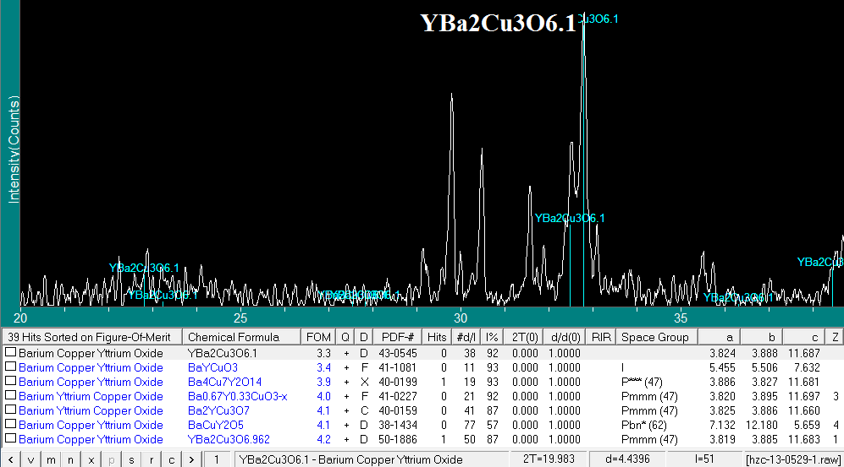
XRD shows what happened to the samples with green components
the XRD result of the green sample

Slide 15
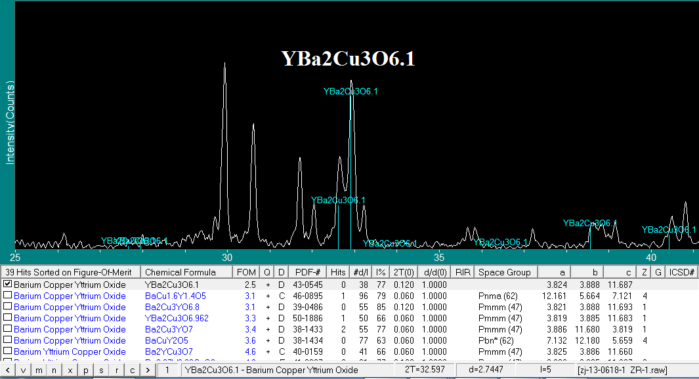
XRD shows what happened to the samples with green components
the XRD result of the green sample（black turn green when exposed ）

Slide 16

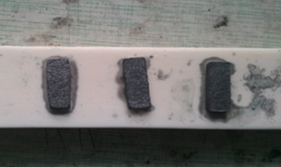
The transition from nonsuperconducting phase into superconducting phase
Cauterizing for 20h

Slide 17
The transition from nonsuperconducting phase into superconducting phase
The occupancy rate of O on Cu(1) - O(1) Loop
decides whether superconducting
（Beno M et al . Appl. Phys. Lett.1987,51:57）

Slide 18
The different superconducting Tc curve
Different thermal adjustment between sample
and thermometer
Behavior like Cooper Pair?
(Resistance of the Superconducting Material YBCO , Chris Safranski, Cal Poly)

Slide 19
Future Work
Exam whether we got single crystal with Laue
Resistance under alternating voltage
Why the resistance become higher as T gets lower ?
Better technological parameters of growing YBCO
……

Slide 20
Physics is like a pizza, it tells that there’s plenty of good stuff on the surface!

Slide 21

Thank you!
Q&A?

