Slide 1
近代物理实验答辩
LABVIEW实验
11光科学与工程系 杨龙
11物理系 邓天泽
指导教师 俞熹

Slide 2
什么是 Labview？
LabVIEW 是实验室虚拟仪器集成环境（Laboratory Virtual Instrument Engineering Workbench）的简称，是美国国家仪器公司（NATIONAL INSTRUMENTS，简称 NI）的创新软件产品。
标准的数据采集和仪器控制软件

Slide 3
什么是 Labview？
LabVIEW是一种图形化编程语言，又称G语言。 其编写的程序称为虚拟仪器VI（Virtual Instrument）。
前面板：控制（control） 显示（indicator）
程序框图：“源代码”

Slide 4
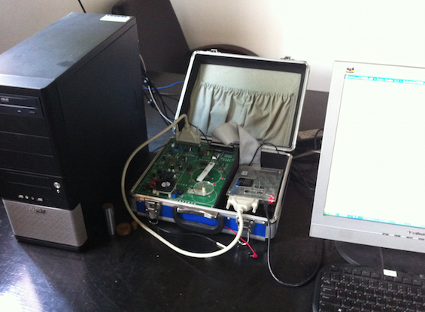
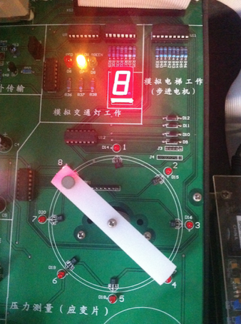
实验仪器
U18 A/D采集卡 传感器 外围电路 计算机

Slide 5
实验内容
模拟电梯
1.当电梯停止时显示黄灯亮起
2.当电梯上行时显示红灯亮起
3.当电梯下行时显示绿灯亮起
4.电梯运行时能够显示相应楼层号和指示灯
5.将电梯按钮可视化，模拟真实情况

Slide 6
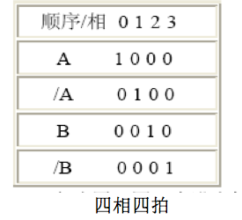
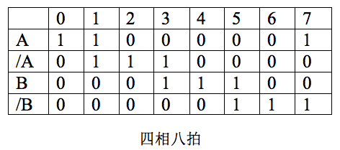
步进电机
驱动方式：四相四拍 四相八拍
延时时间小于20ms时，四相四拍无法正常工作（源代码的缺点）；20ms到40ms时，正常工作。
四相八拍运行更平稳

Slide 7
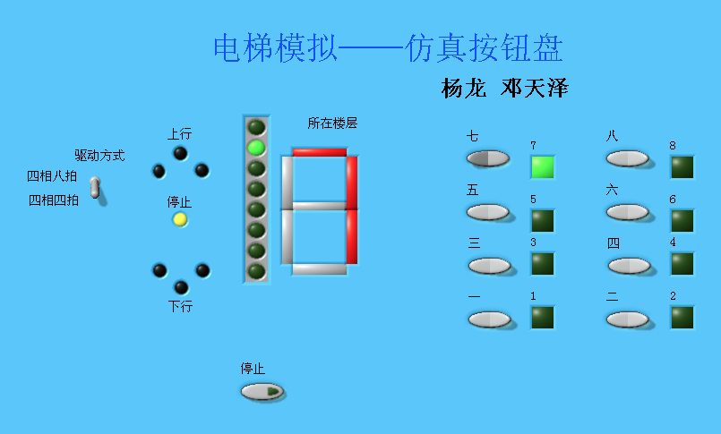
前面板

Slide 8
前面板
Control

Slide 9
前面板
Indicator

Slide 10
程序框图

Slide 11
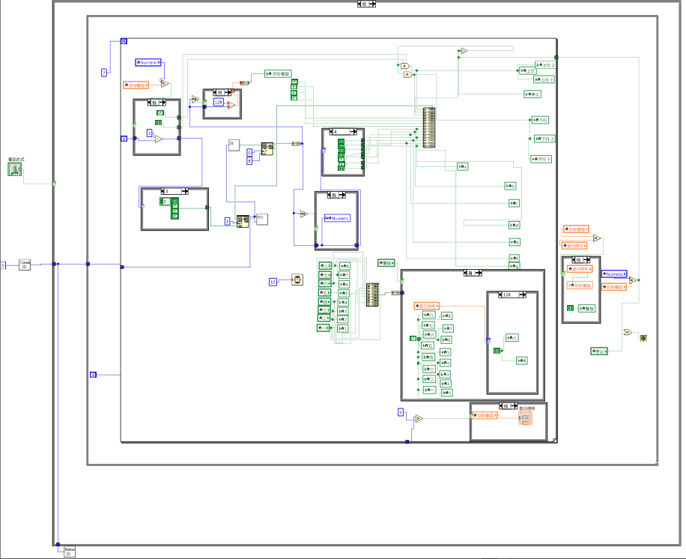
程序框图

Slide 12
程序框图
按照功能大致分为以下部分：
可视化按钮输入
上下行判断
楼层到达判断
楼层指示灯显示
楼层上下行指示灯显示（红黄绿）
楼层数字显示（七段译码）
步进电机

Slide 13
程序框图
楼层指示灯
红黄绿灯
上下行判断
七段译码
步进电机
可视化按钮
楼层到达判断

Slide 14
程序框图
16路开关量数组

Slide 15

采集卡输入输出控制
开关量布尔数组中，后七位布尔数控制前面板上数字指示灯亮，前七位则控制采集卡上的红绿灯亮以及步进电机工作。
红绿灯模板。依次控制红、黄、绿灯
步进电机模板。在固定的时间间隔下，按照四相四拍/四相八拍的驱动方式依次给线圈充电，即可控制电机运动。

Slide 16
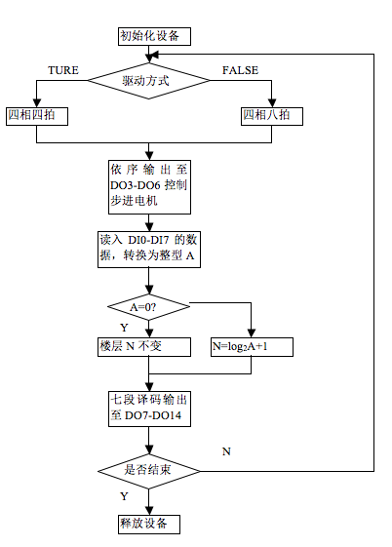
流程图

Slide 17
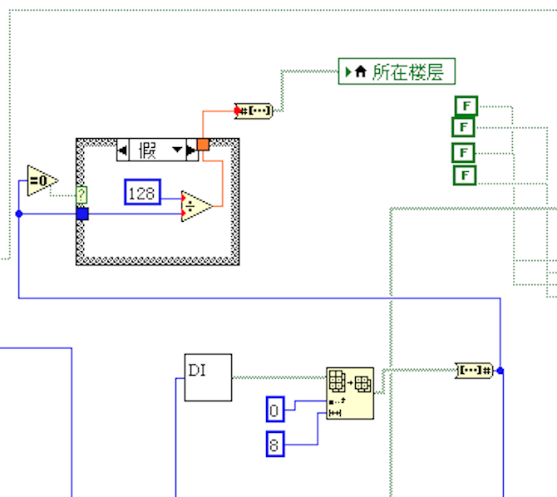
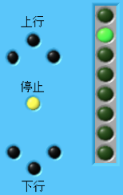
改进之处
正确的楼层指示灯显示
0
0
0
0
0
0
1
0
0
1
0
0
0
0
0
0
第7楼

Slide 18
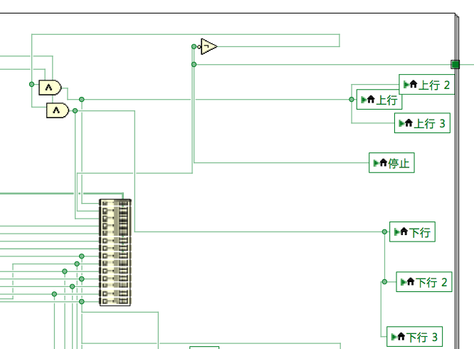
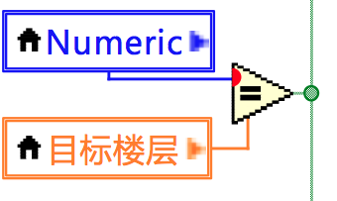
改进之处
红黄绿灯

Slide 19
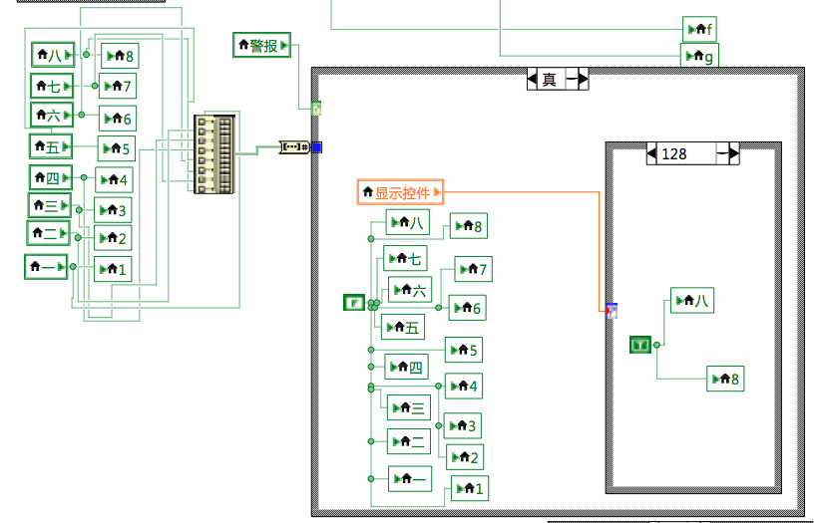
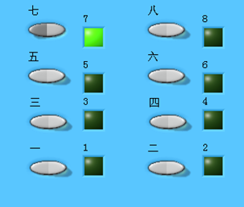
仿真按钮盘
  替换楼层选择按钮，换上类型真实电梯的按钮盘。
  并实现不能更改目标楼层的功能。即电梯运行时按钮盘锁定。

Slide 20
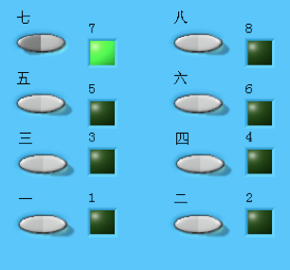
改进之处
仿真按钮盘

Slide 21
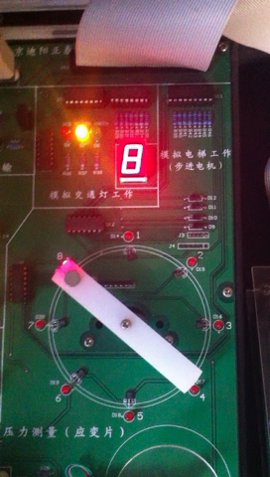
成果展示
下行

Slide 22
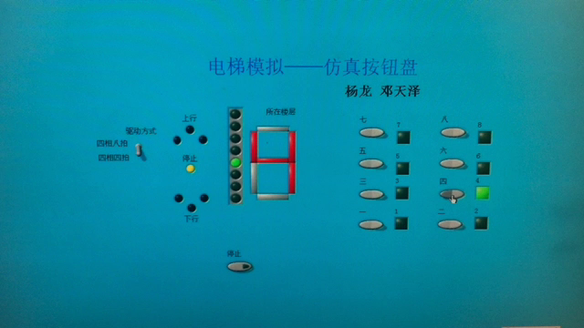
成果展示
上行

Slide 23
今后的工作
1.完全真实的电梯情况
2.上下行 & 多值输入

Slide 24
致谢
感谢俞熹老师，乐永康老师，姚红英老师对我们的指导。
感谢在座的各位同学。

Slide 25
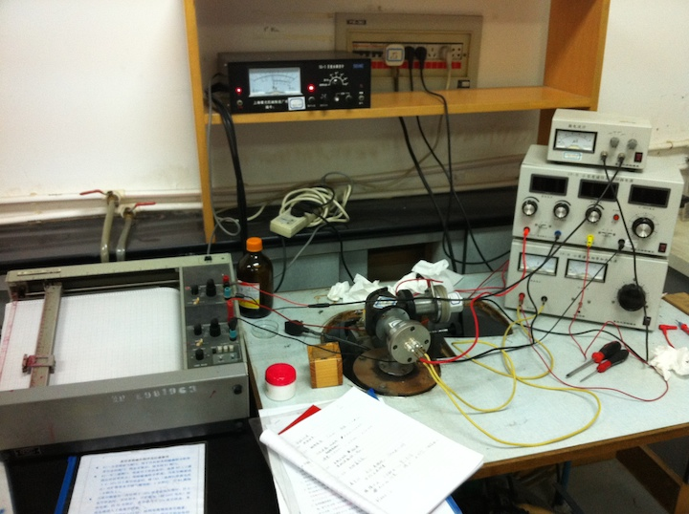
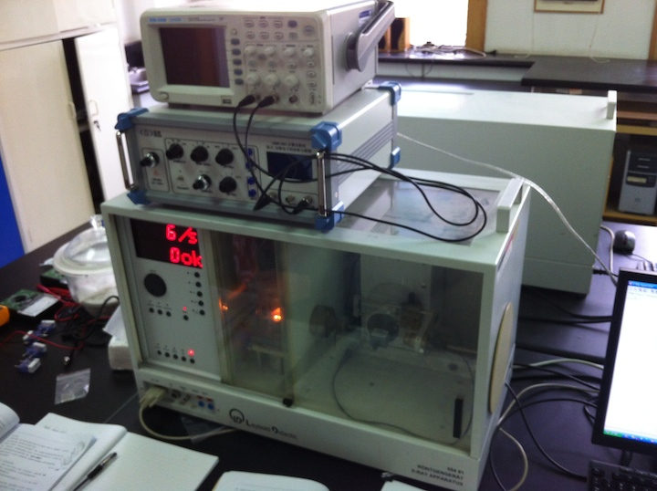
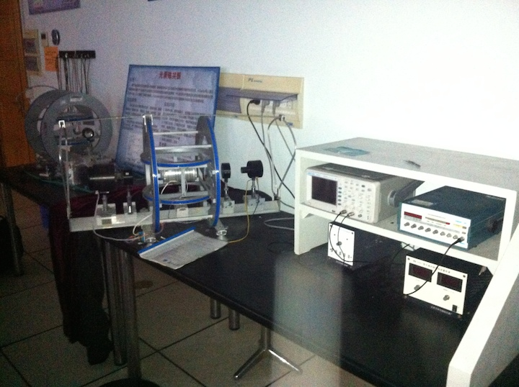
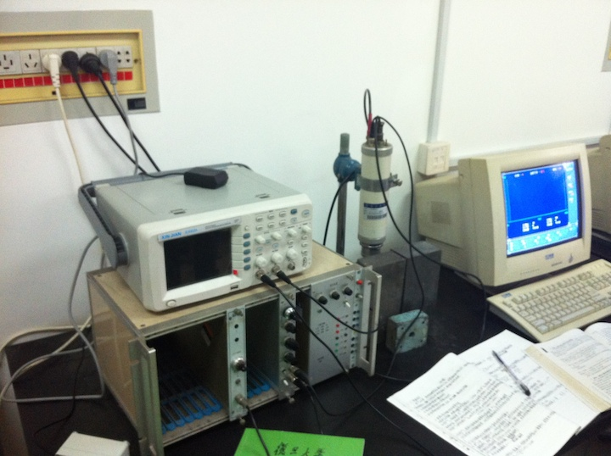
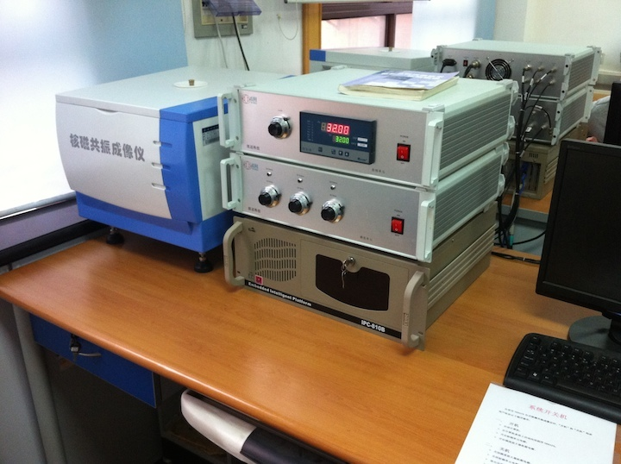
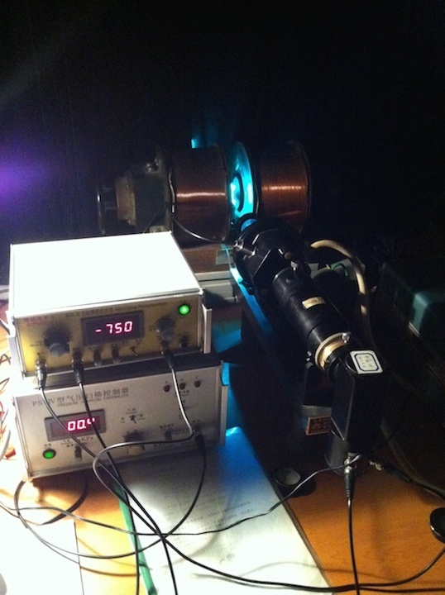
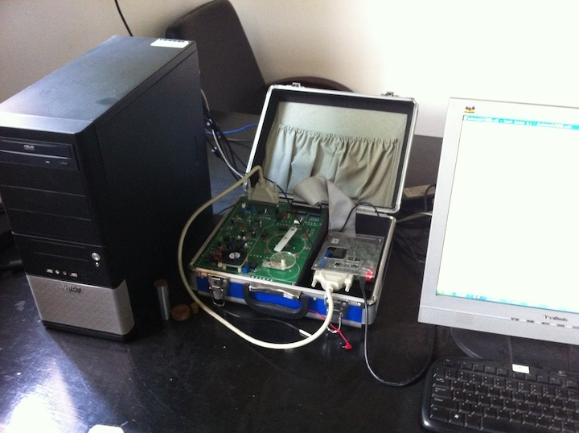
瑾以此页纪念自己在实验室逝去的青春

Slide 26
Thank You
••••••••••••••••••••••••••••••••••
Notes:
Animated dotted line with fade-in text
(Basic)
To reproduce the text effects on this slide, do the following:
On the Home tab, in the Slides group, click Layout, and then click Blank.
On the Insert tab, in the Text group, click Text Box, and then on the slide, drag to draw a text box that spans the entire width of the slide.
On the Insert tab, in the Symbols group, click Symbol. In the Symbol dialog box, do the following:
In the Font list, select (normal text).
In the Subset list, select General Punctuation.
In the Character Code box, enter 2022 to select BULLET, and then click Insert.
Click Insert 33 more times until there is a row of 34 bullets in the text box.
In the text box, select the text, and then on the Home tab, in the Font group do the following:
In the Font list select Arial Black.
In the Font Size box select 44 pt.
In the Font Color list, under Theme Colors select White, Background 1 (first row, the first option from the left).
On the Home tab, in the Drawing group, click the arrow below Arrange, under Position Objects, point to Align, and then do the following:
Select Align to Slide.
Select Align Center.
Select Align Middle.
On the Insert tab, in the Text group, click Text Box.
Drag to draw a text box on the slide.
Enter and select the text.
On the Home tab, in the Font group do the following:
In the Font list select Corbel.
In the Font Size box enter 50 pt.
In the Font Color list, under Theme Colors select White, Background 1 (first row, the first option from the left).
Click Bold.
On the Home tab, in the Paragraph group click Center.
Select the second text box.
On the Home tab, in the Drawing group, click the arrow below Arrange, under Position Objects, point to Align, and then do the following:
Select Align to Slide.
Select Align Center.
Select Align Middle.
To reproduce the background effects on this slide, do the following:
Right-click the slide background area, and then click Format Background. In the Format Background dialog box, click Fill in the left pane, select Gradient fill in the Fill pane, and then do the following:
In the Type list, select Radial.
Click the button next to Direction, and then click From Center (third option from the left).
Under Gradient stops, click Add or Remove until two stops appear on the slider, and customize the gradient stops as follows:
Select Stop 1 on the slider, and then do the following:
In the Position box, enter 0%.
Click the button next to Color, and then under Theme Colors select Blue, Accent 1, Darker 25% (fifth row, fifth option from the left).
Select Stop 2 from the list, and then do the following:
In the Position box, enter 100%.
Click the button next to Color, and then under Theme Colors select Black, Text 1 (first row, second option from the left).
To reproduce the animation effects on this slide, do the following:
On the slide, select the first text box (containing the bullets) and do the following:
On the Animations tab, in the Animation group, click the More arrow to expand the effects gallery, and then under Entrance, click Fly In.
In the Animation group, click Effect Options. Under Direction, click From Left.
In the Timing group, do the following:
In the Start list, select With Previous.
In the Speed list, select 00.50.
In the Delay box enter 10.
In the Advanced Animation group, click Animation Pane. In the Animation Pane, do the following:
Click the arrow at the first animation effect (bullet entrance effect) and click Effect Options.
In the Fade dialog box, on the Effect tab, click the arrow at the Animate text list and click By Letter.
In the % delay between letters box enter 10.
In the Advanced Animation group, click Add Animation, and under Exit, click Fade.
In the Animation group, click Effect Options. Under Direction, click From Left.
In the Timing group, do the following:
In the Start list, select With Previous.
In the Speed list, select 00.50.
In the Delay box enter 00.10.
Click the arrow to the right of the fade exit effect (second effect) and select Effect Options. In the Fade dialog box, do the following:
On the Timing tab, and then under Enhancements do the following:
In the Start list ,select With Previous.
In the Speed list, select 00.50.
In the Delay box, enter 01.50.
In the Animation Pane, do the following:
Click the arrow at the second animation effect (bullet exit effect) and click Effect Options.
In the Fade dialog box, on the Effect tab, click the arrow at the Animate text list and click By Letter.
In the % delay between letters box enter 10.
On the slide, select the second text box (containing text), and do the following.
On the Animations tab, in the Animation group, click the More arrow to expand the effects gallery, and then under Entrance, click Fade.
In the Timing group, do the following:
In the Start list, select With Previous.
In the Speed list, select 00.50.
In the Delay box enter 02.00.
In the Animation Pane, do the following:
Click the arrow at the third animation effect (text entrance effect) and click Effect Options.
In the Fade dialog box, on the Effect tab, click the arrow at the Animate text list and click By Letter.
In the % delay between letters box enter 6.

Slide 27
?
Questioning
?
?
?
?
?
?
?
?
?
?
?

